Slide 1

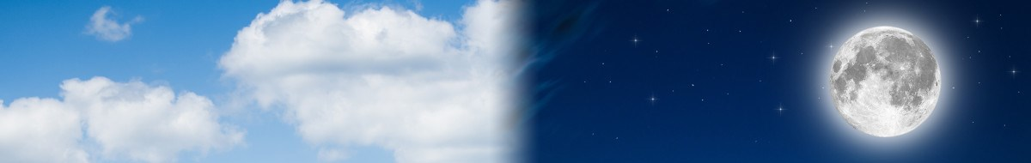
“Between the
Evenings”
“Beyn Ha
Arbayim”

Slide 2


Does the term “between the evenings” have anything to do with Yahuah’s day-start as some theologians adamantly claim?
Thought Provoking Question Today!
Any context
for day-start?
What about ~
“first evening” & second evening”?
2

Slide 3

“Between the Evenings”
CF Notes only:
July 2: start at slide 7. July 3rd – start at 11 AM. Finished to end of slide 13 (theologians).
July 4/19: start at 1030 AM – 830 pm … got to slide 56 with the outline. Ready now to begin at 42.
July 5/19: start at 1:50 – after editing Tersia’s 34 pages. 42-49 in 2.5 hrs.
July 9/19: start @ 4 AM-7AM. 2-6 pm. Done 50-74 … ready to do the quail.
July 10th: start 6 AM. 75-80 Quail done at 750 AM. Finished to 82 – all BTE verses. Have to do Deut 16:6 and Lev 6:20 and Passion Passover and ending. Check Tim’s slides if needed. 945 pm.
July 12th: worked on corrections to #30 and new slides 29 & 30 that took about 3-4 hrs. Just really hard in that Parkhurst spot, and may have to move those slides to the end review and end punch.
July 13th: start at #31 … have to figure out where to begin using “between the mixings” ??? Check spelling of all beyn haa arbayim that they are the same. Corrected to slide 75.
July 14th: CF got to slide 81 – may be in a good order now. Have not checked. Finished 240 AM July 15th
July 15th: TO DO … where do we start to introduce “between the mixingS”? USE mixingS with a different color “S” per TA. CUT SOME OF THE REVIEW SLIDES AND ADD AT LEAST “ONE” OF TA’s CHARTS AT THE BEGINNING FOR A HEAD START. Added slide 61.
July 16th: finished 83-88 on Lev 6:20 grain/meat offering. Dress the slides, and fine tune.
July 17th: 7 PM … edit 83-87 and did #89 on Deut 16
July 18th: 235 PM (Fasting ended here) … finished to slide 100 ending Deut 16 by 940 pm. Hard but got it done.
July 19th 1.5 hrs. + … noon – 330 … up to slide 116 … 5 hrs. today
July 20th: Tim edited to slide 117 … much further than he needed to go.
July 21st: 600 AM – spent till 730 PM on just the Exo 30:8 & Lev 6:20 for the lighting of the lamps. Crazy! Tried to get all the “bunny trail” slides where they need to be, and will fix the text in part 2 later.
White box are Charlene’s notes for what’s going on with this PPT.
July 23rd: 345 PM!! To 200 AM … very hard to get these slides pulled together. Sending to TA for editing.
July 24th: 1100 AM (auntie died – had things to do till now for that. Always something!) noon to 945 pm on 63-68.
July 25th: finished with 62-71 – another huge edit – by 415 pm. -- editing to 630 pm.
July 26th – check all animation – everything for last minute. Start at 930 AM … Finished dressing at 445 pm. Rr….!!
This phrase is very controversial even amongst
the noted historians and commentators.
The question stands: “How can anyone know for sure
what the meaning is”?
Will Covenant Calendar be able to break open
this extremely difficult phrase?
Answer: With all of the information from the Covenant Calendar studies on the word “evening” every student can
be sure to know exactly what “between the evenings” really means, and exactly why this phrase is so important for (perhaps) another new profound truth.
Another question?

Slide 4
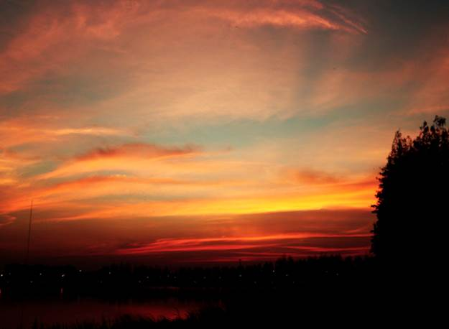
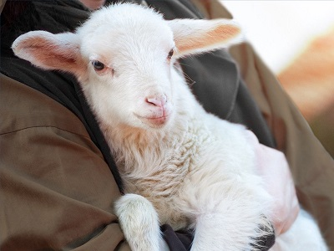
What would that truth be?
1. Does “between the evenings” tell us …
2. Does “between the evenings” tell us …
Or …
Any context
for day-start?
… about Sabbath commencement
according to Torah?
… about a very special sacrifice
according to Torah?
Will the theologians agree with Torah?

Slide 5


Getting Started (An Introduction)
This study will address the Scriptural term <beyn ha arbayim>
(or in English ...) “between the eveningS.”
It has become one of the most confusing and controversial of all Scriptural terms when searching for the true festal calendar – all
for the purpose of salvaging the sunset commencement for Sabbath on Friday evening – or the day before any
Feast Sabbath and especially Day of Atonement.
There are many different opinions on how this term should be defined amongst “the theologians” yet they all claim to have
the true definitions.
However, their definitions are as different as night and day.
Question: How does the everyday common student
discern what is truth and what is error if the theologians can’t
even agree among themselves?
Sunset
day-start!

Slide 6





Getting Started With Questions
As this topic is pondered, the following questions move to the
forefront of this study:
Should a search for the truth about “between the eveningS”
come from the most popular (or favorite) scholar? Or …
Is Jewish tradition a safer place to find the Torah Truth?
1 Peter 3:15 admonishes that “all” are to have a ready word from the
Scriptures. Should every idea, teaching and tradition have to come
under the strict scrutiny of the Hebrew definitions and remain
100% Torah compliant? Then …
Will the Scriptures be able to expose the errors of every counterfeit
teaching that is laced around the phrase “between the eveningS” And …
Is the information really that important for understanding
Yahuah’s festival calendar?
Does “between the eveningS” have anything to do with
defining Yahuah’s day-start or not? Why?
Because this is exactly what many theologians believe and teach!
What about day-start?

Slide 7


Traditional Beliefs Aren’t Reliable!
Before “marrying” a traditional belief of any scholar to the term “between the eveningS” each must learn to unwrap what the Torah has to say first.
The study on Day of Atonement shows there is only
one “evening” in every 24 hour cycle.
Some teachings around “between the eveningS” include
other ideas such as a “first evening” and “second evening”
on every preparation day before any Sabbath with provision
for both terms to be contained in one 24 hour cycle.
Do the Scriptures speak of two evenings in
any 24 hour cycle as part of the definition for
“between the eveningS”?

Slide 8
What can you expect from this study?
Question: Should this study present the truth as found in the Torah to detect and expose any controversial teaching?
While at first it may seem unusual that this
phrase “between the eveningS” needs to
be addressed at all, it must be examined
ONLY because theologians and many
teachers are using this phrase to define
when Yahuah’s day begins.
What’s that
capital “S”
all about?
Unusual for day-start!

Slide 9



Don’t Be Fooled!
This initial study will carefully search out:
There are two
ways to be fooled.
One is to believe
what is not true!
The other is to
refuse to believe
what is true!!
How accepted theologians interpret
“between the eveningS.”
How the Scriptures
of Torah interpret
“between the eveningS.”
Will “between the eveningS” determine Yahuah’s day-start?
If so, what is it?

Slide 10
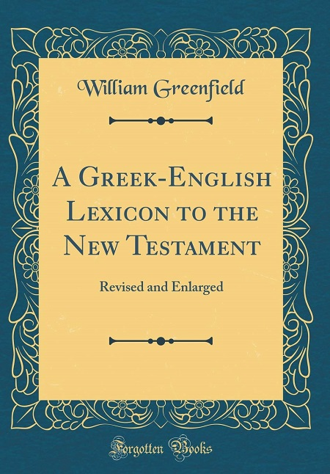
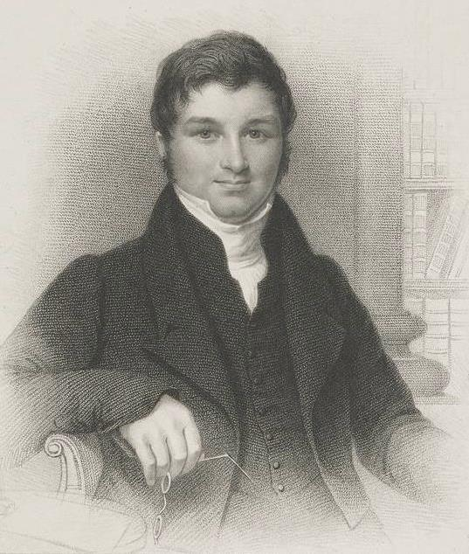
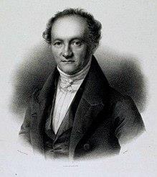
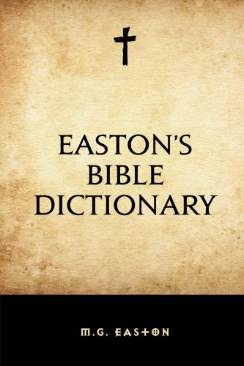
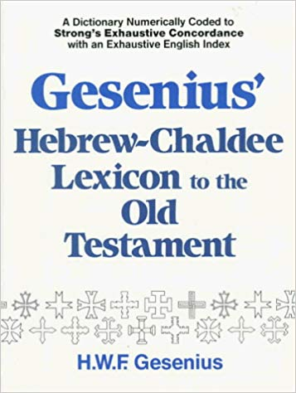
Wilhelm Gesenius
1786-1842
Matthew G Easton
1823-1894
William Greenfield
1799-1831
Theologian’s Commentary Corner
A comparison of the comments between three theologian’s on “between the eveningS.”
Note: These comments are used by many Bible students to form conclusions on the commencement of every Sabbath. These comments will be thoroughly tested!
Sabbath
Day-start?

Slide 11
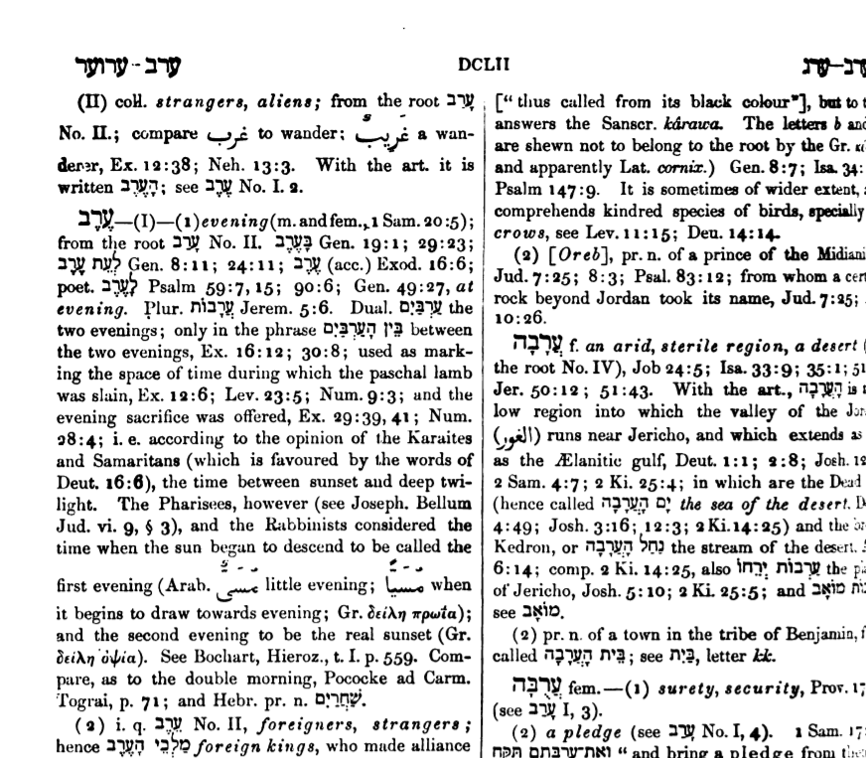
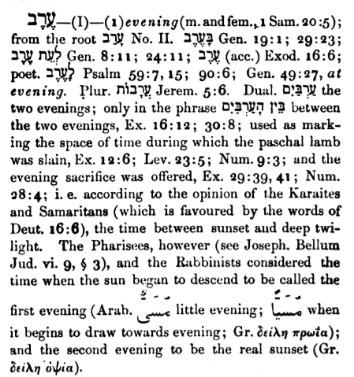
Wilhelm Gesenius
1786-1842
Gesenius Hebrew-Chaldee Lexicon,
"The Pharisees . . . and the Rabbinists considered the time when the sun began to descend to be called the FIRST EVENING (Arabic 'little evening'; when it begins to draw towards evening); and the SECOND EVENING to be the REAL SUNSET" (p. 652, #6153).
https://www.hope-of-israel.org/2evens.htm
>''}-(I)–(1)evening(m. and fem., 1 Sam. 20:5); from the root a y No. II. By; Gen. 19:1; 29:23; sy nº Gen. 8:11; 24; 11; Sy (acc.) Exod. 16:6; poet. iy? Psalm 59:7, 15; 90:6; Gen. 49:27, at evening. Plur, njay Jerem. 5:6. Dual. Dºy the two evenings; only in the phrase Bººl i'i, between the two evenings, Ex. 16:12; 30:8; used as marking the space of time during which the paschal lamb was slain, Ex. 12:6; Lev. 23:5; Num. 9:3; and the evening sacrifice was offered, Ex. 29:39, 41; Num. 28:4; i.e. according to the opinion of the Karaites and Samaritans (which is favoured by the words of Deut. 16:6), the time between sunset and deep twilight. The Pharisees, however (see Joseph. Bellum Jud. vi. 9, § 3), and the Rabbinists considered the time when the sun began to descend to be called the 5,~ * * - first evening (Arab. U-- little evening; º- when * - it begins to draw towards evening; Gr. 3sixm Tpwia); and the second evening to be the real sunset (Gr. 3eiMm Gºpia).
“… But Gesenius, in his Hebrew Lexicon, says that between the two evenings, according to the “best supported” opinion, “was the interval between sunset and dark.”
Notes:
Website: https://books.googleusercontent.com/books/content?req=AKW5Qac4GAY6Z6rqpe026B0xsRlX9v9TCBcxKDWiamaUpBvrD8yr5LlCxrZuqbaWoDhoPq4C_ZHVlM9PVVgdGxHg1LpvUtYnGC-c0UrWAYEkTxa0RPGB7epjlXYaupjld6vIzv-Lmfh2ZDCgrd8-mCsd2mW9Uolzn7-JXwGrz5HQ0vaO-Y6IxAecSzDdwEjy-1lQOrAejuexhGZgKMUpVijRu1k4pPIilOWm03jP9zHDLsIwNY2V6x5qW7QKU4nfwNsqQCRppyDjmoOEP1k3kMKYm8bdvxZR_w

Slide 12
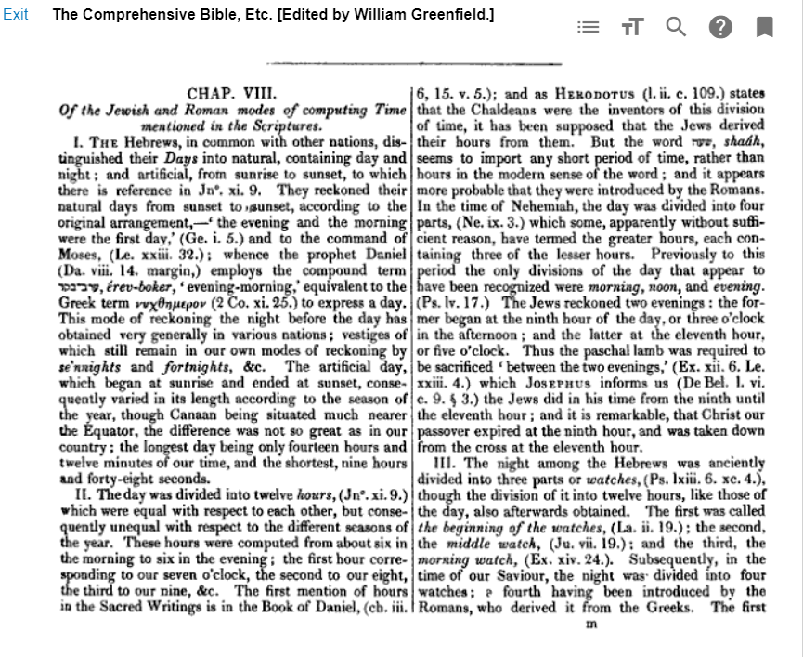
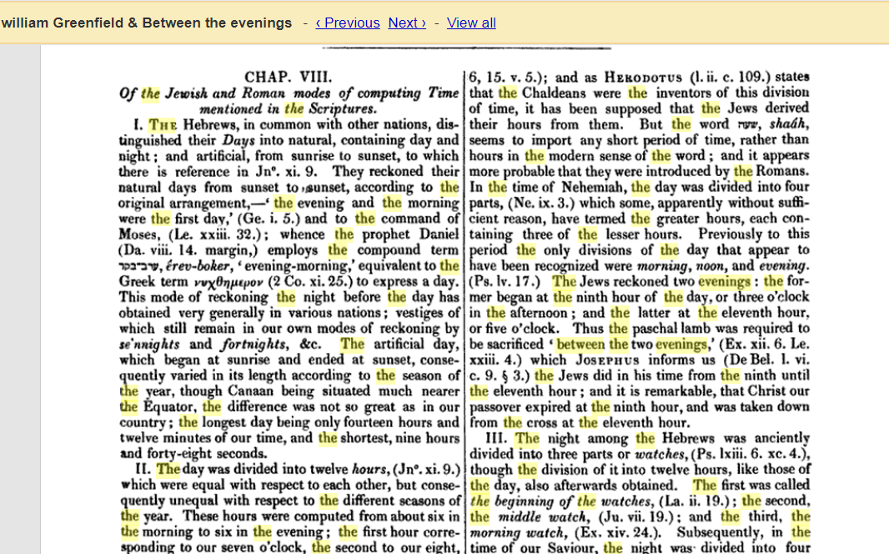
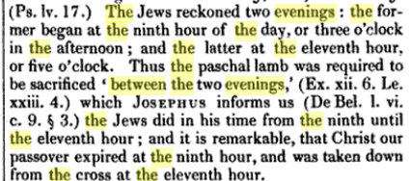
William Greenfield
1799-1831
“Greenfield, in his New testament Lexicon, says that two evenings “were reckoned by the Hebrews; one from the ninth hour, (3 o’clock,) until sunset; and the other, from sunset until dark. Robinson’s Lexicon of the New Testament says the same, this would agree very nearly with Gesenius …”—J. N. Andrews, Nov. 12, 1855. [Emphasis supplied.] This stuff from Andrews is so wrong it is pathetic.
The “first” “even” is from 3 PM to sunset. (More specific than Easton or Gesenius.)
The “second” evening is the period “between sunset until dark.”
Scriptural Verification: “between sunset and dark” is indeed the “dusk twilight” according to the Hebrew definition of <ereb> H6153.
Notes:
Website: https://books.google.ca/books?id=XxthAAAAcAAJ&pg=RA6-PA13&lpg=RA6-PA13&dq=william+Greenfield+%26+Between+the+evenings&source=bl&ots=8Sii6iQL3r&sig=ACfU3U08EvO1I2XYQpFpKhY3Ilczxr92vA&hl=en&sa=X&ved=2ahUKEwiTxbvYw5njAhVNrJ4KHb_fA9gQ6AEwAXoECAkQAQ#v=thumbnail&q=william%20Greenfield%20%26%20Between%20the%20evenings&f=true

Slide 13

Matthew G Easton
1823-1894
Easton’s Bible Dictionary Definitions [very popular]:
Daily sacrifice: (Daniel 8:12; 11:31; 12:11 [Note: “sacrifice” is a supplied word in all 3 texts!]), a burnt offering of two lambs of a year old, which were daily sacrificed in the name of the whole Israelitish people upon the great altar, the first at dawn of day, and the second at evening (Daniel 9:21 [?]), or more correctly, "between the two evenings." (See SACRIFICE.)
Evening: the period following sunset with which the Jewish day began (Genesis 1:5; Mark 13:35 [?]). The Hebrews reckoned two evenings of each day, as appears (?) from Exodus16:12; 30:8; 12:6; (marg.) Leviticus 23:5 (marg. R.V., "between the two evenings"). The "first evening" was that period when the sun was verging towards setting [beginning at high noon], and the "second evening" the moment of actual sunset. The word "evenings" in Jeremiah 5:6 should be "deserts" (marg. R.V.).
https://www.christianity.com/bible/dictionary.php?dict=ebd&id=960 (Emphasis supplied.)
Note:
Mark 13:35 context is the 2nd
options
coming of: evening, midnight, rooster crowing
& dawn!
Context for
day-start?
Did you notice how his definition of the 2nd evening somehow defines the Sabbath commencement?
13

Slide 14

Do the Theologian’s Agree?
 | Evening begins: | Noon 6th Hr | 9th Hr 3 PM | 11th Hr 5 PM | Sunset | Dusk [Ereb] | Deep Twilight | Explanation of Between the Evenings
1 | Gesenius |  |  |  |  |  |  | Just gives review for lines 1a and 1b.
1a | Karaites & Samaritans |  |  |  |  |  |  | Between sunset and deep twilight.
1b | Pharisees & Rabbinists | 1st Even |  |  | 2nd Even |  |  | Between noon and sunset.
2 | Greenfield (& the Jews) |  | 1st Even | 2nd Even |  |  |  | Between 3 PM to 5 PM. (9th Hr to 11th Hr)
3 | Easton (Claims Jews have two [2] evenings on each day!) | 1st Even |  |  | 2nd Even | [Period that follows sunset!] |  | Between noon and sunset.
Does “between the eveningS” mean there are 2 evenings in each 24 hour cycle?
Is one of the theologians right, or are they all wrong?!
Will Torah agree with any of these concepts for the placement of “between the eveningS”?

Slide 15


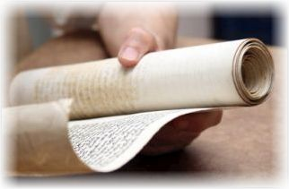
The Theologian’s cannot agree because of one
simple mistake!
They neglected to check
out the full meaning
of the word(s)
evening/evenings
The next part of this study will be a very thorough investigation to reveal the
Torah Truth of “between the eveningS”!

Slide 16
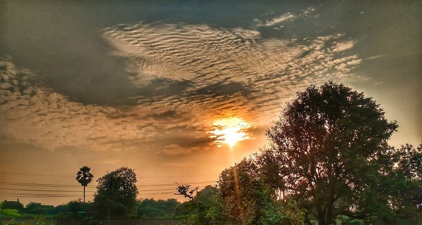
Review from Grammar 101 Part 2 on “evening” <ereb; H6153> as the Introduction to Part 4
to understand
“between the eveningS”
According to Torah
does this picture
explain the phrase
“between the evenings”?
16

Slide 17

Review
Definitions for “evening”
<ereb> H6153
In Gen 1 the word “ereb”
first refers to dusk.
H6153 has other noun
definitions besides “dusk.”

Slide 18
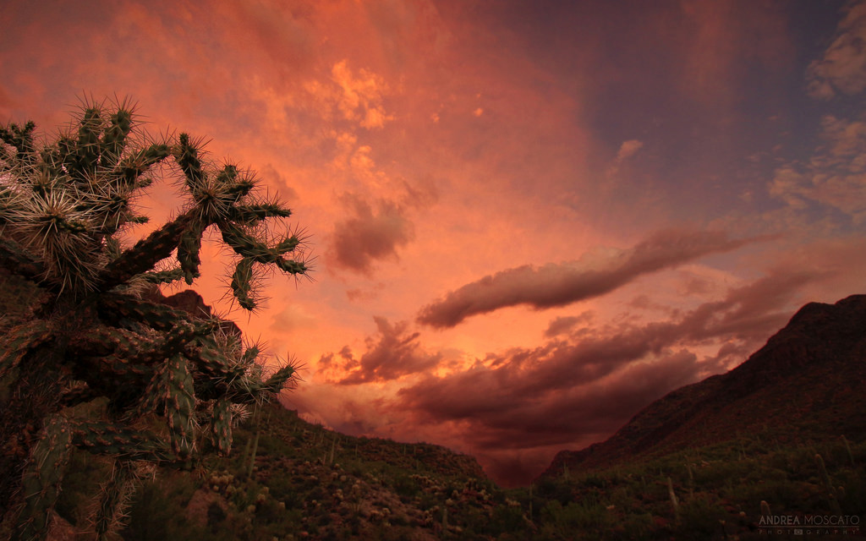
Understanding Evening
1st Definition of Evening is a “mixing” of light and night – or – dusk twilight.
There are 2 new
noun definitions that
will include the
Day & Night Seasons.
REVI
EW

Slide 19


Evening: 2nd Definition
[2nd definition H6153] “day”
Because … “day”
seems to be opposite
of the term “evening.”
Because evening is
defined as a “mixing
of light and night.”
However: “Evening” is not “the day,” but part of the “Day Season.”
Coming up:
The phrase “between the eveningS”
will show how “evening” qualifies as part
of the Day Season.
At this point
many question
why “day”
is ever listed
as a definition
for “evening”!
Review
Why?

Slide 20

Evening: 3rd & 4th Definitions
[3rd definition H6153] even (-ing, tide)
[‘eventide’ - old English term meaning dusk "twilight.”]
[4th definition H6153] “night”
Why?
Review
Because … “night” is very different from evening;
Because … “evening” is not part
of the Night Season.
However … Coming up:
The phrase “between the eveningS” will also qualify for the Night Season.
How can “ereb” link to night?
Does “night”
sound like
a definition
for “evening”?
N
EW

Slide 21
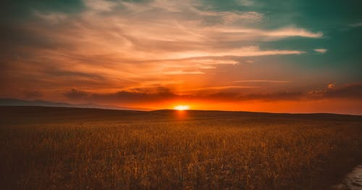
Evening H6153 Definitions
Review
[1st def.] dusk ["twilight”] [2nd def.] “day”
[3rd def.] even (tide) ["twilight”] [4th def.] “night”
Note: Sunset [shemesh bow] is NOT
one of the definitions for <evening>.
Sunset is a point of time that ushers in <ereb>.
R
EVI
EW
“sun” H8121 shemesh; to be brilliant; the sun.
“going down” H935 bow'; a primitive root; to go or come.
“evening” H6153 is not the same as “sunset” [H8121 & H935] !

Slide 22
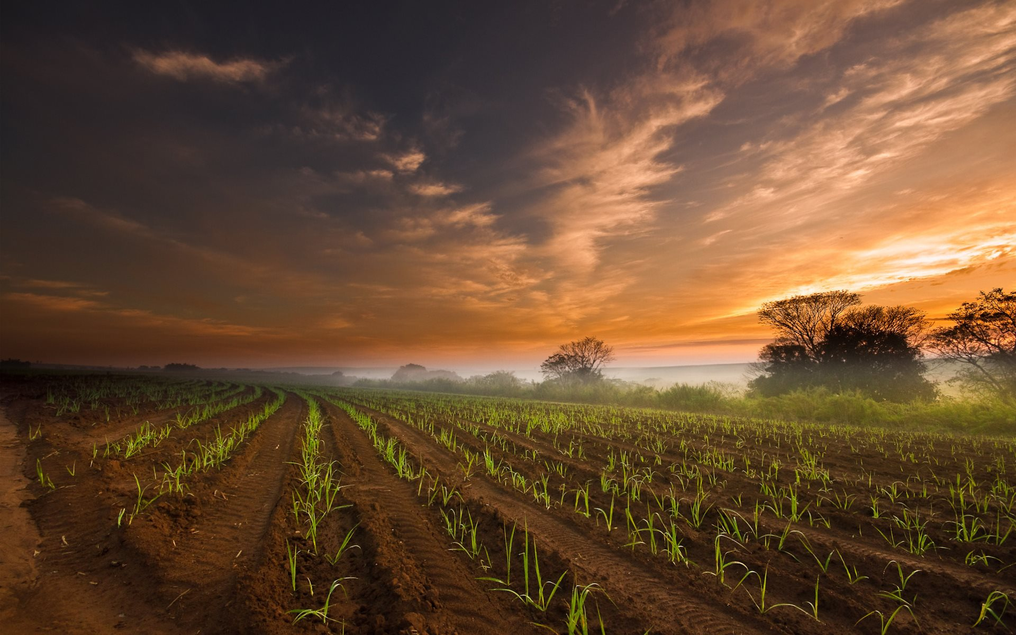

Question:
Ever wonder why there is so much emphasis
on “evening” in the Covenant Calendar study?!
Review
“Evening” is: 1) the trickiest, most challenging term to understand correctly;
2) It is Covenant Calendar’s cornerstone!

Slide 23
Extra work on the
primitive roots
of “evening”
<ereb> H6153
Review
The word “evening” actually goes back to two primitive roots!

Slide 24
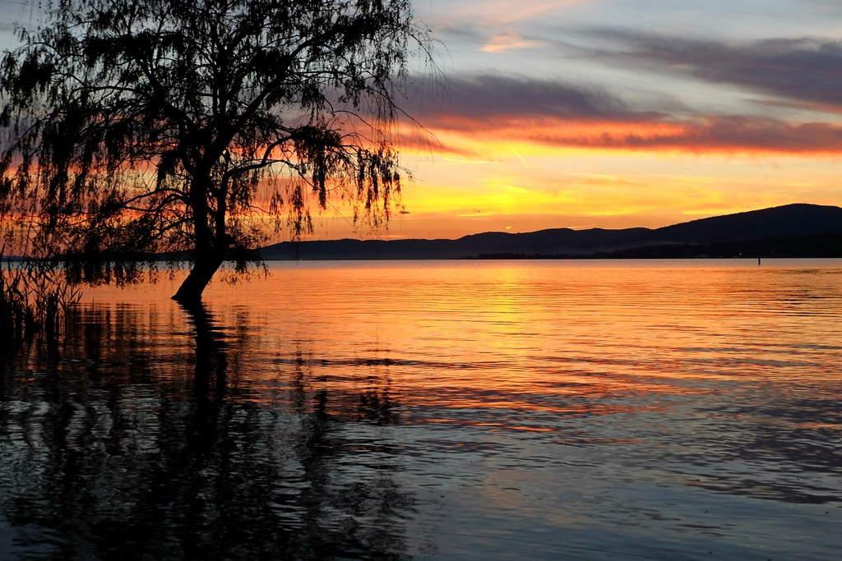
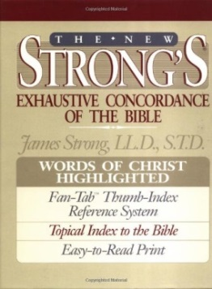
More About “primitive roots”
Review
The first mention of “evening” in Gen 1:5 is <ereb> H6153.
HOWEVER, there are two primitive roots to be considered:
H6153 [noun] `ereb (eh'-reb); from H6150;
dusk: KJV - day, even (-ing, tide), night.
  H6150 [verb] `arab (aw-rab'); a primitive root
  [identical with H6148 through the idea of covering with a texture];
  to grow dusky at sundown: KJV - be darkened, (toward) evening.
    H6148 [verb] `arab (aw-rab'); a primitive root; to braid, i.e. intermix; technically, to traffic (as if by barter);
    also or give to be security (as a kind of exchange):
    KJV - engage, (inter-) meddle (with), mingle (self),
    mortgage, occupy, give pledges, be (-come, put in) surety, undertake.

Slide 25
Question:
Why are there
two primitive roots [p.r.]
for the word “evening”?
Review
Answer: Because there are
two twilights
in every 24 hour cycle!
What does that mean?

Slide 26

1st p.r.) H6150 “arab” aligns with evening twilight.
H6153 [noun] `ereb; from H6150; dusk: KJV - day, even (-ing, tide), night.
  H6150 [verb] `arab; a primitive root
  ([identical with H6148 through the idea of covering with a texture]);
  to grow dusky at sundown: KJV - be darkened, (toward) evening.
Duskiness described:
Review
H6148 [verb] `arab; a primitive root; to braid, i.e. intermix; KJV - meddle (with), mingle.
This is where many get the idea that evening has the definition of sunset for Gen 1:5.
Another Description
How?
Twilight H5399 nesheph; properly, a breeze,
i.e. (by implication) dusk
(when the evening breeze prevails):
KJV - dark, dawning of the day (morning), night, twilight.

Slide 27


2nd p.r.) H6148 “arab” aligns with morning twilight.
<boqer> is always morning twilight.
Morning H1242 <boqer> dawn, break of day
Twilight H5399 nesheph;
properly, a breeze, i.e. (by implication) [#1] dusk (when the evening breeze prevails):
KJV - dark,
[#2] dawning of the day (morning),
night, twilight.
REVI
EW
Twilight <nesheph> is always a mixing.
How does morning
& twilight align
with “arab”?
How?
H6148 [verb] `arab;
a primitive root; to
braid, i.e. intermix;
KJV - meddle (with), mingle.
H6148 defines
any kind of mixing
including <boqer> twilight.
Watch for one more condition!
The condition is going to be: arab 6148 only aligns with boqer with the phrase BTE – in the plural form, because 6148 includes ALL mixings.
Where will this lead to next?

Slide 28
Putting it all Together (H6150 & H6148)
Evening/ereb H6153
(as a noun)
Morning/boqer H1242
(as a noun)
REVI
EW
Twilight mixing of
light and night.
Twilight at the end of
the Light Season.
Verb: dusky mixing
Twilight mixing of
night and light.
Twilight at the beginning of the Light Season.
Verb: plough; break forth
Evening/arab H6150
(as a verb/mixing)
Morning/baqar H1239
(as a verb/mixing)
<arab H6148> is the “verb” for ALL mixings & twilights.
Evening/ereb qualifies for the arab H6150 (dusky mixing).
Morning/baqar qualifies for the arab H6148 (general mixing).
Defined as: ereb arab
Defined as: boqer arab

Slide 29

You might be wondering:
This seems confusing!
Where is this leading to?
Are there any good answers?
It’s time to check another lexicon for the next piece of information after an important note!

Slide 30
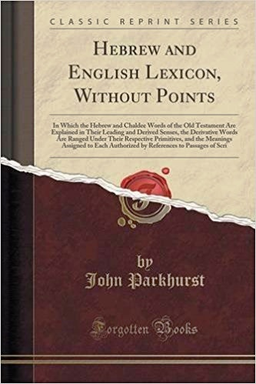
J Parkhurst [1762] Comments on “ereb”
Gesenius 1786-1842
Greenfield 1799-1831
Easton 1823-1894
Note: These 3 theologians very likely used J Parkhurst to gather
their personal interpretation of “beyn ha arbayim.”
And yes, you will find each of their individual interpretations within
the 2-3 very extensive pages on “ereb” in Parkhurst’s work.
Question & Thought to Ponder:
Then why is it these theologian’s do not agree with each other?
A Note From Covenant Calendar
While many theologians and commentators “pick and choose” what they want from the works of others, for the purpose of supporting their own ideas, or the ideas of the Rabbis, Pharisees, Sadducees and Karaites, etc. – quite frankly – Covenant Calendar is going to do the same thing!
However, there will be one major exception!
Covenant Calendar will stay true to Parkhurst’s interpretation when it comes to addressing the correct meaning of “beyn ha arbayim” in connection with the many (and varied) Torah Scriptures. This evidence is being presented so each person can make their own honest assessment about this important topic!

Slide 31
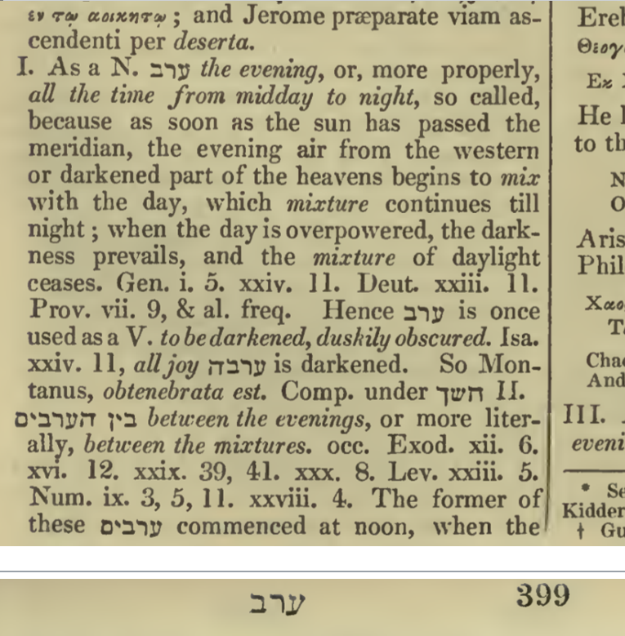

ב
ר
ע
Basics of “even” for “ereb”
and “beyn ha arbayim”
ם
י
ב
ר
ע
ה
ן
י
ב
Note #1: The 3 theologians freely attached the “noun” definitions to “beyn ha arbayim” [mixture] which brings forth the idea there are 2 [two] “evenings” in each cycle, choosing between:
a) noon to 3 PM b) noon to sunset
c) 3 PM to sunset d) sunset to night.
Deut 23:11 does allude to the “evening” beginning in the later afternoon moments, before the sun is down (as noted below).
Will this have anything
to do with
Deut 16:6?
Deut 23:11 But it shall be, when evening cometh on, he shall wash himself with water: and when the sun is down, he shall come into the camp again.
Note #2: Not one of the theologians use Parkhurst’s VERB definition for “beyn ha arbayim” that he connects to 10 Torah verses!
ב
ר
ע

Slide 32
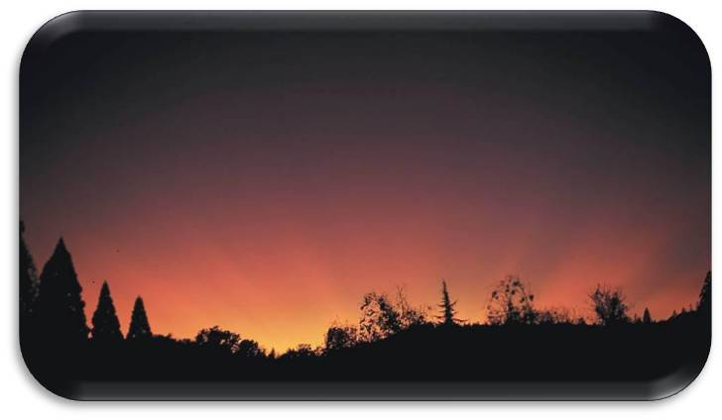
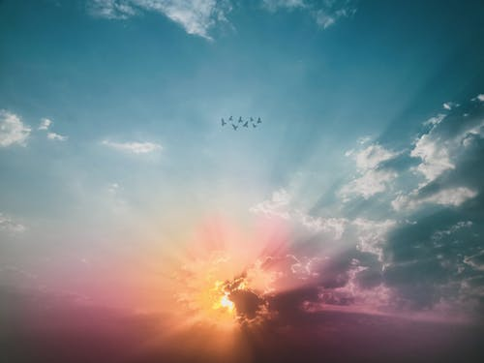
Basics of “ereb”
primitive roots
FIRST
Review
ב
ר
ע
Ereb – Evening
J Parkhurst Notes: [A Hebrew Lexicon - 1762 ]
Besides the definitions of mix, mingle,
to be darkened, & duskily obscured,
he also includes the phrase:
[beyn ha arbayim]
between the eveningS;
or more literally …
between the MIXTURES.
ם
י
ב
ר
ע
ה
ן
י
ב
Does this have
anything to do
with the nouns
and verbs?

Slide 33

Beyn Ha Arbayim
ם
י
ב
ר
ע
ה
ן
י
ב
R
E
V
I
E
W
Beyn
(Between)
Arbayim
(mixtures)
Ha
(the)
Question #1:
How many “evenings/erebs” are there in 24 hours?
Question #2:
How many “mixtures/arabs” are there in 24 hours?

Slide 34
A look at the phrase
“between the eveningS”
[“beyn ha arbayim”]
using <ereb> H6153
& <arab> H6148
Review
A comparison of tenses:
singular & plural.
[ereb] [arab]

Slide 35
“ereb” [H6153] as a noun;
“arab” [H6150 & H6148] as a verb
NEXT!
NEWEST
Many definitions for arab are
descriptive action words.
Every ereb twilight is an arab “mixing”!
(noun) (verb)
Boqer/morning [the noun] identifies a “mixing”
of the Light [noun] with the Night [noun].
Arab, when it is applied to morning {boqer}, also describes the mixing of
[the action/verb]
“light and darkness” in the morning.
(Note: Every boqer is an arab only when there is a qualifier.)
REVI
EW

Slide 36

“Nouns” and “Verb Tenses”
Working Together
[ereb/evening twilight] [H6150: singular arab/mixing]
[boqer/morning twilight] [H6148: plural arab/mixingS]
Morning/boqer: Dawn’s 1st LIGHT
Next boqer: Dawn Begins A New Cycle
Morning action described as “arab” twilight mixture.
R
E
V
I
E
W
Sunrise
Sunset
Evening/ereb action:
“arab” twilight mixture.
Direct Sunlight
Darkness
The morning/boqer twilight qualifies for the H6148: plural arab/mixingS only with the phrase “between the eveningS.”

Slide 37
Understanding
the placement of
“between the eveningS?”
(“between the mixingS”)
Review
Understanding
“arab” [H6148] is paramount for clarity on
“between the eveningS.”

Slide 38
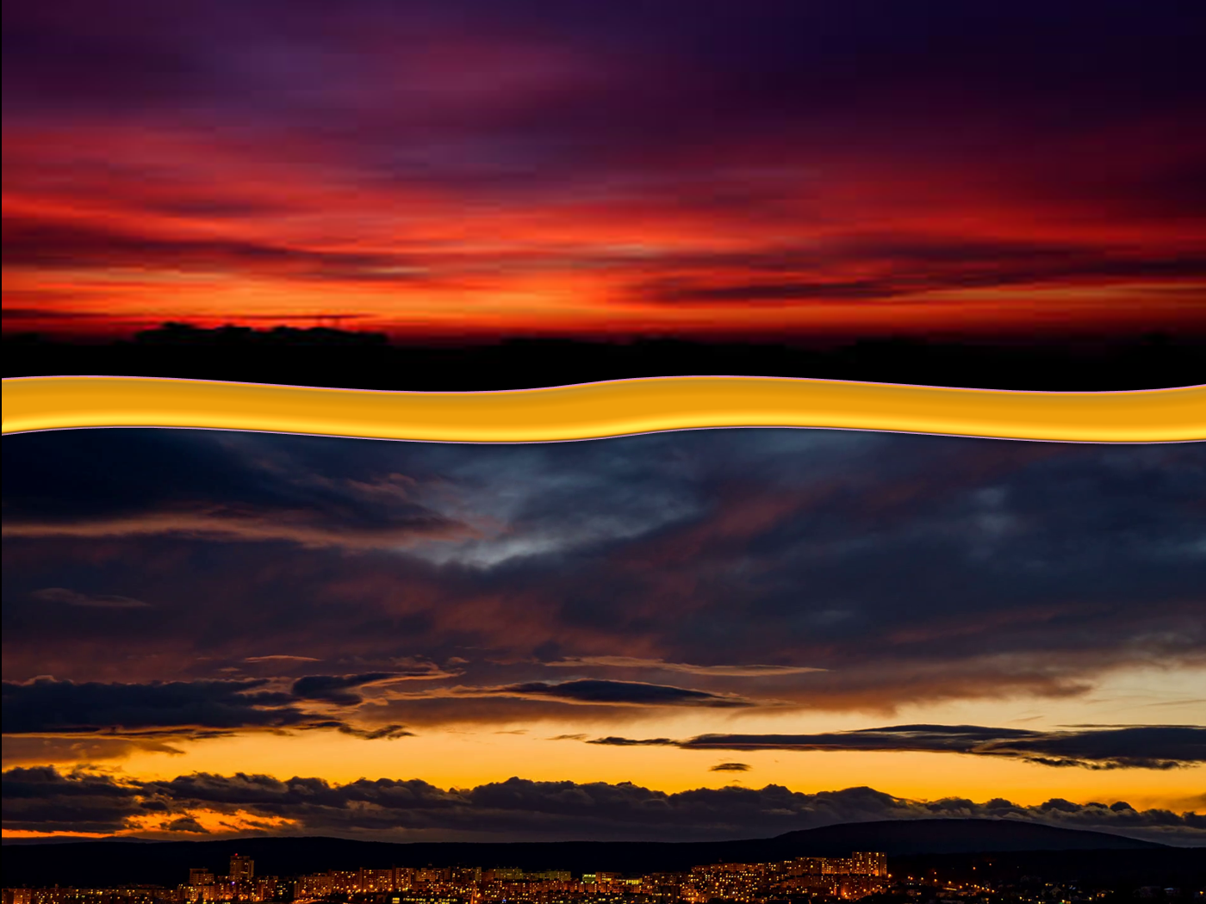
The “singular” form of “evening” <ereb arab>
rightly claims the 1st definition as “dusk”
[the mixing of light and night].
Thus, <ereb> is always the dusk twilight.
REVI
EW
Evening <ereb> can only claim the
2nd definition of “day” or the
4th definition of “night”
[where both components consist of no mixing
through the phrase <between the mixingS>]
… WHEN linked to a “qualifier”!

Slide 39

What is that qualifier?
The context of the Scripture
The term “between the eveningS.”
R
E
V
I
E
W
One “qualifier” is when the verb form of “ereb” changes from singular to plural.
Instead of only “ereb” in the verse,
the plural form of “ereb” [arab]
is present in “beyn ha arbayim” ~
or “between the eveningS.”

Slide 40




Plural form of “ereb” as
“beyn ha arbayim” ~
(“between the eveningS”)
R
E
V
I
E
W
There is only one evening
(dusk twilight) in every 24 hour cycle.
Question: How can there be
two eveningS in any 24 hour cycle?
OR: Would there be two mixingS
in any/all 24 hour cycles?
REVI
EW
This will be demonstrated next.

Slide 41
Every 24 Hr Cycle has Two ‘arabs’
[boqer/morning arab/mixing] [ereb/evening arab/mixing]
beyn ha arbayim:
“between the mixingS”
Dawn
Dawn
REVI
EW
Morning/boqer:“arab”
Evening/ereb:“arab”
Sunrise
Sunset
1. beyn ha arbayim
Day Season
(between the mixings)
2. beyn ha arbayim
Night Season
(between the mixings)
Direct Sunlight
Darkness
Context determines the specific beyn ha arbayim.

Slide 42

The Phrase “beyn ha arbayim” is Unique!
There are a total of 11 Torah Scriptures
that use the phrase “beyn ha arbayim.”
Grammar 101 - Part 4: The full meaning of “between the eveningS.”
(Note: “between the mixingS” is a better interchangeable term.)

Slide 43
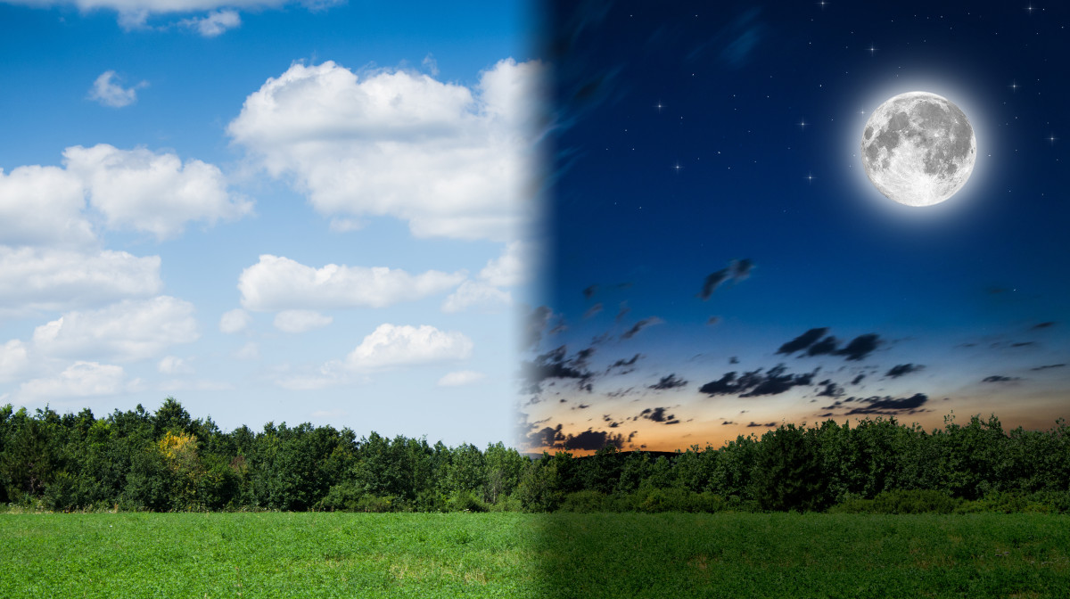

2. What about
Lev 6:20 &
Deut 16:6?
1. What about
Patterns for
“between the eveningS”
in Torah?
What about
Patterns for
“between the eveningS” on Yahusha’s
Passover Day?
Anything for
day-start?
Part #1 of this study will be a very thorough investigation
to reveal the Torah Truth of “beyn ha arbayim”!
43

Slide 44
Introductory Questions
Even though it may appear that the phrase “between the eveningS” has something to do with the day commencement this may be
far from correct. What if this phrase:
  … connects to the “Daily Sacrifices” – especially the 2nd daily offering?
  … is also heavily connected to the timing of the Passover sacrifices?
  … aligns with neither of the above?
This study must begin with showing the
difference between <ereb; H6153> as either:
  “evening”
  “between the eveningS” (“between the mixingS”)
  (or) two “evenings” such as: i) “first evening” or… ii) “second evening”
Keep these three choices in mind for every Torah verse that uses
the Hebrew term “between the eveningS/mixingS” in this investigation.
Anything for
day-start?

Slide 45
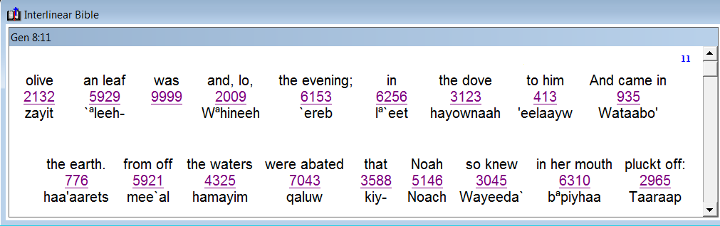
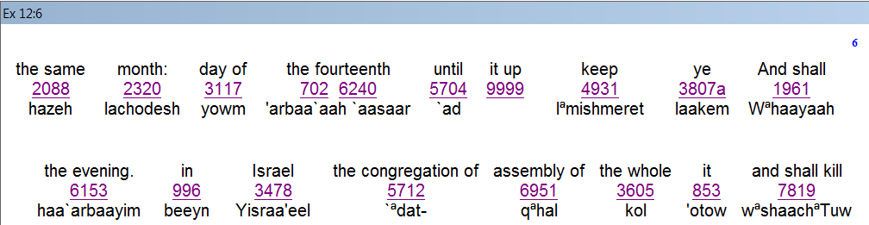
Clarity Before Confusion
This phrase “between the eveningS” is mistakenly considered controversial.
Therefore, it needs attention to be understood according to the Hebrew language definitions.
Gen 8:11
“in the evening”
And the dove came in to him
in the evening; and, lo, in her mouth
was an olive leaf pluckt off …
Gen 8:11 uses <`ereb> in the singular form for evening.
Exo 12:6
“in the evening”
And ye shall keep it up until the fourteenth day of the same month: and the whole assembly of the congregation of Israel shall kill it in the evening.
Exo 12:6 uses <`arbayim> in the plural form for evening.

Slide 46
Correction for Clarity in English
Singular Form
“in the evening”
This form of in the evening
<ereb H6153]>
refers to the Dusk Twilight mixing following the Light Season.
<`ereb> in the singular form for evening as H6153.
Plural Form
“in the evening”
This form of in the evening
<beyn ha arbayim H966 & 6153>
refers to both “mixingS” including the
Dawn Twilight following the Night Season.
<`arbayim> in the plural form for evening as H966 & 6153.
The phrase “between the eveningS” can be defined as “between the mixingS” according to Torah and <H6153> definitions of J Parkhurst.

Slide 47
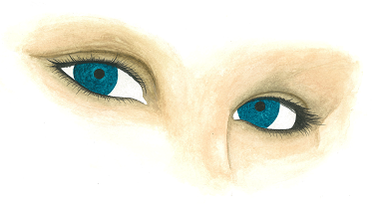
Awareness of 2 Different Formats
The phrase
“in the evening” <beyn ha arbayim> cannot be recognized in the
English mindset.
Watch for this in the Hebrew.
Also watch content & context for “beyn ha arbayim”
if it aligns to Yahuah’s Sabbath(s) commencement.

Slide 48

Awareness of 2 Different Timeframes
Every Torah Phrase of
<beyn ha arbayim> “between the mixingS”
has 2 options of placement:
Dawn
Dawn
REVI
EW
Morning/boqer:“arab”
Evening/ereb:“arab”
Sunrise
Sunset
1. beyn ha arbayim
Day Season
(between the mixings)
2. beyn ha arbayim
Night Season
(between the mixings)
Direct Sunlight
Darkness
Context determines the specific “timeframe.”

Slide 49
“between the mixingS”
[beyn ha arbayim]
Found 11 times
in Torah!
Overview
Part 1: Torah contains all 11 references for this phrase in 5 categories:
Quail Event: Exo 16:12
Daily Sacrifices:
Exo 29:39; Exo 29:41; Num 28:4; Num 28:8
Passover Lamb Sacrificed:
Exo 12:6; Lev 23:5; Num 9:3
Partaking of the Passover Lamb:
Num 9:5 [1st month]; Num 9:11 [2nd month]
Sanctuary Lamps: Exo 30:8
For a specific reason this study will NOT be presented in the original order of Torah Texts.
Part 2: The following verses will also be considered that are not normally included with the phrase <beyn ha arbayim> but are connected to sacrifices:
Lev 6:20 … Daily Grain Offering with Evening Sacrifice
Deut 16:6 … Passover Sacrifice Guiding Principle

Slide 50
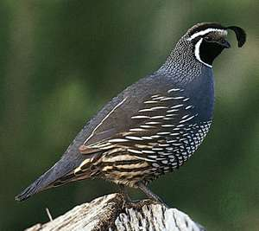

A) Quail Event & Testimony
Important note:
This study reveals how the keys of a Torah
truth can be hidden in a Dawn day study.
Before examining Exo 16:12, verse 8 must be
examined first and verse 13 last in the proper order.
The timeframe is the 2nd month after leaving Egypt.
This example shows very clearly the timing for
“between the mixingS” can be contained in
either the Day Season or the Night Season.
There will be a comparison of phrases for English & Hebrew:
  “in the evening” [ba ereb]
  “at even” as … [beyn ha arbayim]
#1
Exo 16:12

Slide 51
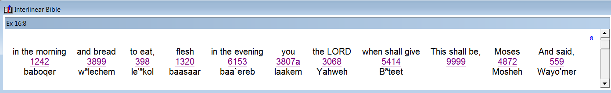
Quail/Manna Information (Exo 16:8)
And Moses said, This shall be, when Yahuah shall give you
in the evening (at dusk twilight <H6153 ba `ereb>) flesh to eat, and
in the morning (at dawn twilight <H1242 boqer>) bread to the full …
#1
Exo 16:12
The Hebrew phrase used here is <H6153 ba `ereb>) meaning the dusk twilight – the time when the quail could be easily captured when they come in to roost for the night (vs 13).
The arrival of the quail at the end of the day around dusk twilight is still part of the
Day Season.
Next: Verse 12 gives details on “when” the quail will be eaten.

Slide 52
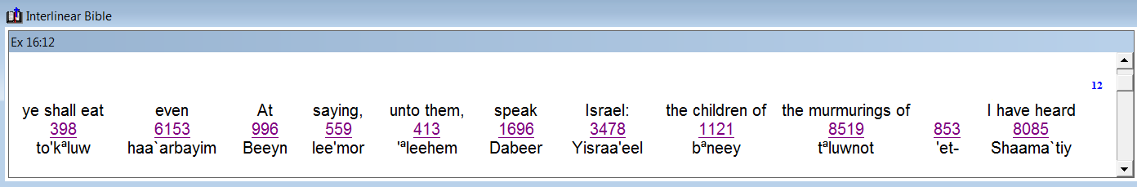
Quail/Manna Command (Exo 16:12)
I have heard the murmurings of the children of Israel:
speak unto them, saying,
At even (<beyn ha `arbayim>) ye shall eat flesh, and
in the morning (at dawn twilight <H1242 boqer>) ye shall be filled with bread …
#1
Exo 16:12
The Hebrew phrase used here is <H6153 beyn ha `arbayim >) meaning “between the mixingS” – of the Night Season which naturally follows the dusk twilight.

Slide 53

Quail Mini-Summary (Exo 16:8, 12)
Because there are Torah Keys in the Quail account to break open the understanding of <beyn ha arbayim> extra information will be given.
#1
Exo 16:12
Verse 8: the quail would arrive at dusk, just after sunset <baa `ereb>.
People would not be eating the quail until <beyn ha `arbayim>.
<beyn ha `arbayim> follows <ba `ereb>.
(<boqer H1242> does not follow <ba `ereb>).
<beyn ha `arbayim> as “between the mixingS” refers to
ONLY the Night Season in this account.

Slide 54
Quail Mini-Summary (con’t)
Some may believe that <beyn ha `arbayim> refers to only the Day Season
between sunrise and sunset – which is the timeframe between the Dawn mixing
<arab> and the Dusk mixing <arab>.
As will be shown this is the timeframe “between” TWO mixings of “light and night.”
Remember: The Hebrew word <`arbayim> is plural for <arab mixingS>.)
Also remember: There is never more than one “evening/dusk twilight mixing” in each
24 hour cycle. But, there are TWO “twilight mixingS” in every 24 hour cycle.
Therefore, in Exo 16, this phrase of <beyn ha `arbayim> can only apply to
eating the quail between the darkness of night and the breaking of the
dawn day – considered as the Night Season.
This is the exact witness needed to verify the Exo 12 Passover sacrifice
and meal in Egypt – had their placement during the Night Season.
New events happened at the dawning of the new day in both Exo 12 and Exo 16:
  Exo 12: any left-over Passover lamb had to be burned before Abib 15 morning.
  Exo 16: the manna/bread was found upon the ground at the first morning twilight.
#1
Exo 16:12

Slide 55
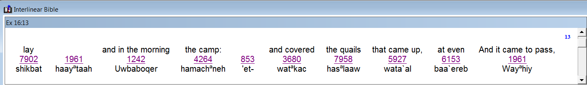
Quail/Manna Arrival (Exo 16:13)
And it came to pass, that at even (dusk twilight <baa `ereb>)
the quails came up, and covered the camp …
#1
Exo 16:12
Again, verse 13, confirms that the quail arrived at the
<baa `ereb> meaning dusk twilight of the Day Season.
Exodus 16 is a perfect example defining the difference
between the singular “evening” and the plural “eveningS.”
The mention of the plural for “eveningS” or “mixingS”
has nothing to do with any day commencement.
No context
for day-start.

Slide 56
The Quail of the 2nd Month
The phrase “between the two mixingS”
in Exo 16 aligns with ONLY
the Night Season.
Dawn
Dawn
1. Arrival of the quail at <ereb> dusk.
#1
Exo 16:12
Sunrise
Sunset
2. Preparation & eating of the quail during the Night Season.
DUSK
beyn ha arbayim
Night Season
(between two mixings)
Direct Sunlight
Darkness
It is impossible for <beyn ha arbayim>
to qualify for the Day Season in Exo 16.
beyn ha arbayim
Day Season
(between two mixings)

Slide 57
B) Daily Morning & Evening Sacrifices
INTRODUCTION
Before this discussion proceeds to the Daily Sacrifices, one should be aware that the priests (in the Gospels) at the sanctuary were NO LONGER offering
the Daily Sacrifices according to the Torah instructions.
Somehow the morning and evening sacrifices (to be offered at dawn and dusk according to the Torah) were moved, or changed, to the 3rd hour and the
9th hour of each Day Season.
Therefore, Yahusha’s sacrifice NOW has to fulfill both:
  His Torah requirements for sacrifices and …
  The actual corrupt practices of the Aaronic priests (for their sacrifices)
  at the sanctuary on His Passover day.
This is amazing & EXACTLY WHY
the phrase “between the eveningS” BECOMES SO IMPORTANT.
Before the term “between the eveningS” can be fully understood, a very thorough investigation of the Daily Sacrifices needs to be completed
from Exodus 29 using the better English term of “between the mixingS.”

Slide 58
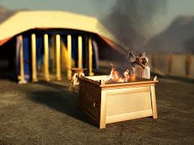
B) Daily Morning & Evening Sacrifices
Exo 29:38 KJV
(The Daily Offerings – using the example of the 10th day of the month.)
Now this is that which thou shalt offer upon the altar; two lambs of the first year day by day continually.
  Two sacrifices are to be offered during the Day Season of
  only ONE day, not stretched over a Sunset Theory period that would include 2 different days (such as the 10th [at dawn] and
  the 11th [at dusk after sunset]) for one daily offering.
Daily Sacrifices in
1 year = 730

Slide 59
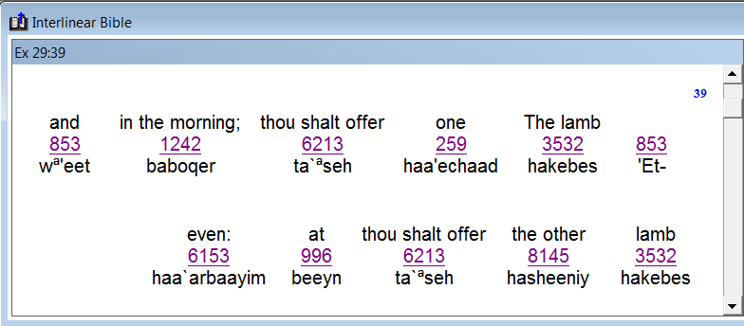
B) Daily Morning & Evening Sacrifices
Exo 29:39 One lamb thou shalt offer in the morning [H1242],
and the other lamb thou shalt offer at even
[H6153 “between the mixingS”]:
#2
Exo 29:39
1st Lamb of the 10th day is offered during the morning twilight as the light breaks forth on the 10th day of the month.
2nd Lamb on the 10th day is
to be offered during <beyn ha arbayim> or “between the mixingS.”
(Later: more information will be supplied using Lev. 6:20.)
Cf: Lev 6:20 grain offering was offered with each daily offering and here allows for the gr. offering with the 2nd sacrifice to be at night <ereb H6153>. This is an interesting exception.
These instructions keep the two continual Daily offerings ON the SAME day, every day, for both morning and evening sacrifices, in that order – morning first and evening second!
Why? Because sunset does not change Day 10 to Day 11.
Question: What was happening at the sanctuary for the timeframe of the evening sacrifice during Yahusha’s ministry as Judea’s sunset calendar ushered in a new day?
There is a close correspondence between the Burnt Offering [for atonement] and the Grain Offering [for worship] because the two offerings are often carried out together. The Grain Offering was often an adjunct of another offering (cf. Exod. 29:38-46; Lev. 23:9ff.; Num. 6:13ff.; 7:13, 19, etc.; 8:8; 15:1-9). The 28th and 29th chapters of the Book of Numbers most dramatically demonstrate the association between the Grain and the other offerings. The Grain Offering was instructed by God to follow the Burnt Offering (Num. 28, cf. also Josh. 22:23, 29; Judg. 13:19, 23). Thus, while the Grain Offering itself does not atone, there is atonement very near at hand whenever the Grain Offering takes place.

Slide 60

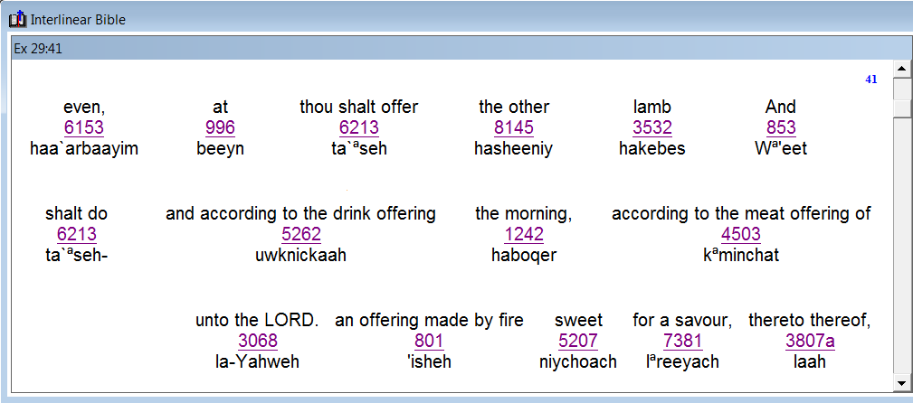



B) Daily Morning & Evening Sacrifices
Exo 29:40-42 And with the one lamb a tenth deal of flour mingled with the fourth part of an hin of beaten oil; and the fourth part of an hin of wine for a drink offering.
41 And the other lamb thou shalt offer at even, [H6153 “between the mixingS” <beyn ha arbayim>] and shalt do thereto according to the meat [grain] offering of the morning, and according to the drink offering thereof, for a sweet savour, an offering made by fire unto Yahuah.
#3
Exo 29:41
Verse 41 is a 2nd witness as to when these Daily Offerings are to be done – both on the same day no matter what day it is.
What about an “evening sacrifice” being offered during dusk twilight?
42 This shall be a continual burnt offering throughout your generations at the door of the tabernacle
of the congregation before Yahuah: where I will meet you, to speak there unto thee.

Slide 61
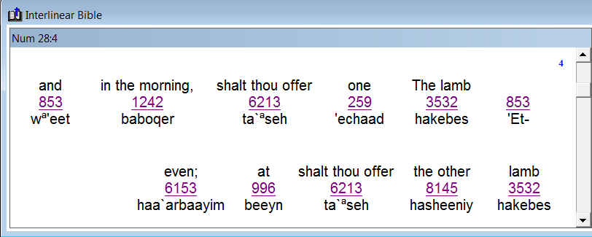
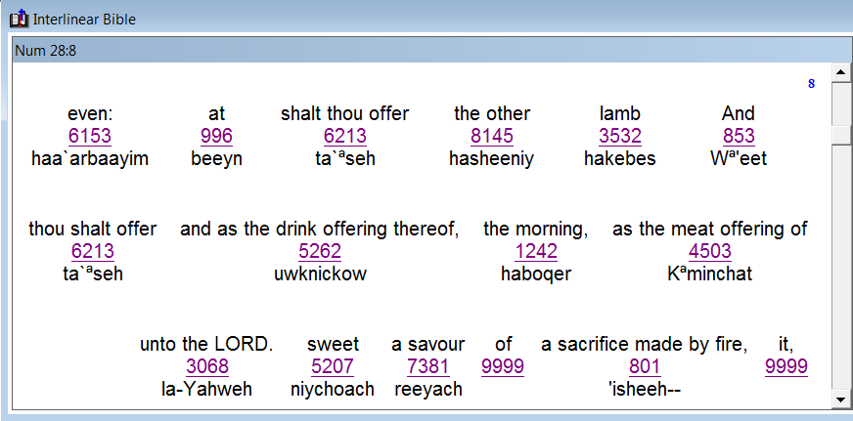
B) Daily Morning & Evening Sacrifices
These Scriptures are 2nd witnesses to the
Exo 29 Scriptures for the Daily Sacrifices.
Num 28:4 The one lamb shalt thou offer in the morning, and the other lamb shalt thou offer at even (H6153 between the eveningS/ beyn ha `arbayim) [“between the mixingS”].
#4
Num 28:4
#5
Num 28:8
Num 28:8 And the other lamb shalt thou offer at even (H6153 between the eveningS/ beyn ha `arbayim) [“between the mixingS”]: as the meat [grain] offering of the morning, and as the drink offering thereof, thou shalt offer it, a sacrifice made by fire, of a sweet savour unto Yahuah.
Does this mean the “evening sacrifice” can NEVER be offered during dusk twilight?
We shall see!

Slide 62



What About the Evening Daily Sacrifices?
Do the 4 phrases: “between the two mixingS”
in Exo 29 & Num 28 align with
ALL 3 options below?
Dawn
Dawn
#2
Exo 29:39
#3
Exo 29:41
#4
Num 28:4
#5
Num 28:8
Sunrise
Sunset
DUSK
beyn ha arbayim
Day Season
(between two mixings)
beyn ha arbayim
Night Season
(between two mixings)
Direct Sunlight
Darkness
Is it possible another sacrifice can qualify for all three options during the 24 hour cycle?
No context
for day-start.

Slide 63

Historical Evidence From Josephus
Solving Covenant Calendar puzzles
involves asking many questions.
Prov 25:2 KJV
It is the glory of Yahuah to conceal a thing: but the honour of kings is to search out a matter.
Thought Provoking Questions Ahead!
That is exactly what we are going to do on the next slides ~ start searching with questions!
63

Slide 64

Covenant Calendar Format
The 1st Daily sacrifice was to be performed in the “morning”
at Dawn Twilight <boqer H1242>.
IF the “evening” sacrifice is to follow the same pattern would we expect to find it performed during the Dusk Twilight <ereb H6153>?
Why does it appear Yahuah has given an exception for the
2nd Daily Sacrifice to be offered “between the mixingS”
rather than “during the mixing” of Dusk Twilight?
Exo 29:39
&
Num 28:4
“The one lamb shalt thou offer
in the morning
and the other lamb shalt thou offer
at even.
[between the
eveningS]
Dawn
Dawn
Sunrise
Optional Lamb:
“between the mixingS”?
Sunset
1
Day 1 Light
1
Day 1 Night
2
1st Lamb:
morning/boqer
[dawn twilight]
2nd Lamb:
even/ereb
[dusk twilight]
The morning sacrifice never had the option to be offered after sunrise.

Slide 65
Questions for Daily Torah Sacrifices
Did Yahuah know a corrupt priesthood would change His original intent? Yes!
Question: Because He knows the
“end from the beginning,” did He build
in an alternative phrase so Yahusha could/would fulfill every sacrifice through His one Passover sacrifice
even through a corrupt priesthood?
Does the true Messiah have to fulfill:
a) ALL the Torah sacrificial timing commands? … AND …
b) ALL the sacrificial timing
commands of the corrupt
Aaronic priesthood in Judea?
What was Yahuah’s original intent for the timing of the morning and evening sacrifices?
Would He have had in mind that each day is best to begin with the morning sacrifice and each day
was to be ended with
the evening sacrifice?
In Covenant Calendar format, this arrangement would have contained both sacrifices on the same day.
However, there is an alternative provision for
the evening sacrifice.
Why did Yahuah provide
for the evening sacrifice to have an optional placement during the Day Season?
Dawn
Dawn
Why?
Sunrise
Optional Lamb:
“between the mixingS”?
Sunset
1
Day 1 Light
1
Day 1 Night
2
1st Lamb:
morning/boqer
[dawn twilight]
2nd Lamb:
even/ereb
[dusk twilight]
65

Slide 66
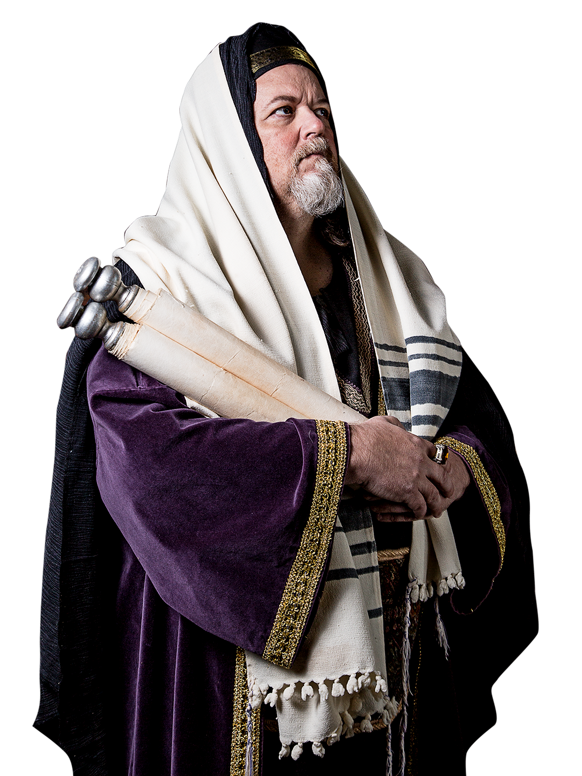

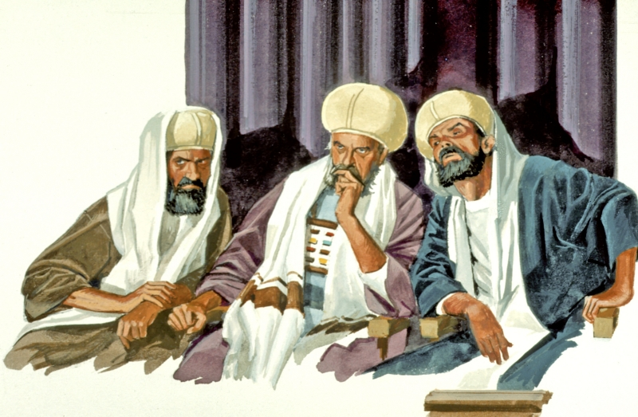
Eventually the corrupt priests began offering
the two Daily Sacrifices
on their OWN
lunar~calendar schedule
in the temple
at Jerusalem.
(approx. 450 BC)
To justify A SINGLE DAY, on their ‘sunset to sunset’ day calendar, AND keep the sacrifices in the same order as “morning first” and “evening second,”
they instituted several changes.
[TA] how do you know it was in canaan?
sunset theory came about around 450 BC.
You asked the question about "why in Canaan" when the corrupt priests changed the times for the sacrifices. My answer: The command from Moses in Deut 16 was "when they come into the land" ... remember there were no passovers in the wilderness after year #2, so these instructions are for "coming into the land" ... of what? ... of Canaan, right? Then, he said "at the place where Yahuah places His name, you go there for passover" ... well, that is Jerusalem, IN JUDAH by that time -- after the land of Canaan was split into 12 tribe divisions. I could say Jerusalem - but that's not totally correct, because Joshua celebrated Passover when he crossed the Jordan into "their" canaan. So, that is why I used canaan. Do you think another term is more correct to identify what Deut 16 is talking about - as this is coming up in part 2? But, trouble is: it has to be done correctly in part 1. So, I felt "canaan" was a safer term "all around" than "Jerusalem" which didn't come about for some time, nor the tribe of Judah. That all took time to divide up the land for the inheritances. Let me know if you want canaan changed out.
The next thing to consider!
They were up
to something!
66
Notes:
You asked the question about "why in Canaan" when the corrupt priests changed the times for the sacrifices. My answer: The command from Moses in Deut 16 was "when they come into the land" ... remember there were no passovers in the wilderness after year #2, so these instructions are for "coming into the land" ... of what? ... of Canaan, right? Then, he said "at the place where Yahuah places His name, you go there for passover" ... well, that is Jerusalem, IN JUDAH by that time -- after the land of Canaan was split into 12 tribe divisions. I could say Jerusalem - but that's not totally correct, because Joshua celebrated Passover when he crossed the Jordan into "their" canaan. So, that is why I used canaan. Do you think another term is more correct to identify what Deut 16 is talking about - as this is coming up in part 2? But, trouble is: it has to be done correctly in part 1. So, I felt "canaan" was a safer term "all around" than "Jerusalem" which didn't come about for some time, nor the tribe of Judah. That all took time to divide up the land for the inheritances. Let me know if you want canaan changed out.

Slide 67
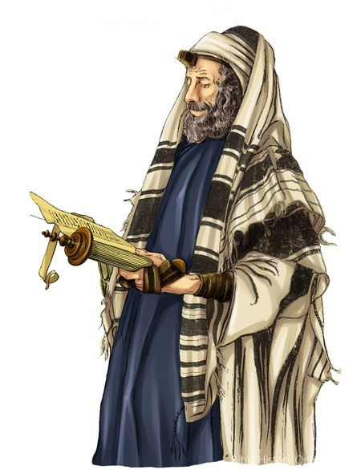


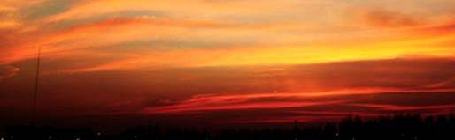
A Sunset Calendar Scheme!
What were
they up to?
1st: The Evening sacrifice was set
for the 9th hour [3 PM Roman time]
rather than leaving it at the
dusk twilight.
… Manipulating the original intent for
the timeframe of
the sacrificial laws!!
Remember: Yahuah knows the end from the beginning!
Exo 29:39
&
Num 28:4
The one lamb shalt thou offer in the morning, and the other lamb shalt thou offer at even.
[between the
eveningS]
Sunset Starts
the Day
Sunset Starts
NEW Day
Sunrise
“Taking away
the key of
knowledge.” Luke 11:52
All sacrifices had to be on ONE 24 hr “day” from sunset to sunset!
1
Day 1 Night
1
Day 1 Light
2
Note: Through stretching & taking advantage of Yahuah’s provision for the yearly evening/Passover sacrifice to be offered BEFORE dusk twilight, the priests developed an evening in the afternoon
for every sacrifice – in fact 2 evenings! HOW?
2nd Lamb:
evening sacrifice
[was permanently
moved]
[between the eveningS] became connected to this timeframe.
67

Slide 68


When all the dots are connected, this study will eventually
show the priests disregarded the actual Hebrew meaning
of the word ereb <a mixture> … THEN applied their own
definition of <sun going down> to facilitate
an afternoon “evening”!
Connecting the Dots!
Just where would these “evenings” be placed?
68

Slide 69
A Sunset Calendar Scheme
that has “2” Evenings!
What were
they up to?
… Manipulating the original intent for
the timeframe of
the sacrificial laws.
Popular Placement
of 2 evenings!
Exo 29:39
&
Num 28:4
The one lamb shalt thou offer in the morning, and the other lamb shalt thou offer at even.
[between the
eveningS]
Sunset Starts
the Day
Sunset Starts
NEW Day
Sunrise
“Taking away
the key of
knowledge.” Luke 11:52
Remember: Yahuah knows the end from the beginning!
1
Day 1 Night
1
Day 1 Light
2
#1
#2
Two “evenings” on ONE 24 hour “sunset day” –
neither one contains a mixture of light and darkness!
(See slide 12.)
2nd Lamb:
evening sacrifice
[was permanently
moved]
1st Evening: 6th hr to sunset (Noon to sunset)
2nd Evening: 9th hr to sunset (3 PM to sunset)
This is how
[between the eveningS] became connected to
these two timeframes.
69

Slide 70
A Sunset Calendar Scheme!
What were
they up to?
2nd: The Morning sacrifice was moved from DAWN twilight to
the 3rd hour [9 AM Roman time].
(For convenience?)
… Manipulating the original intent for
the timeframe of
the sacrificial laws.
Remember: Yahuah knows the end from the beginning!
Exo 29:39
&
Num 28:4
The one lamb shalt thou offer in the morning, and the other lamb shalt thou offer at even.
[between the
eveningS]
Sunset Starts
the Day
Sunset Starts
NEW Day
Sunrise
“Taking away
the key of
knowledge.” Luke 11:52
All sacrifices are on ONE 24 hour “day” from sunset to sunset!
1
Day 1 Night
1
Day 1 Light
2
Question: Why would the priests bother to move the boqer sacrifice to
mid-morning? Even on their ‘sunset day’
the morning sacrifice was still on “the
same day” as THEIR EVENING sacrifice!
1st Lamb:
morning sacrifice
[was permanently moved]
2nd Lamb:
evening sacrifice
[was permanently
moved]
For Question Box above: July 25/19 crf … I placed this comment here because I believe they would have been challenged by the people why the morning sacrifice was at dawn, and the evening was mid-afternoon. We have to remember the common people did NOT have a copy of the Torah - no way to check out what the priests were doing, or teaching, to see if they were following Torah. I believe the boqer change was to "take away an awareness" or "common sense" from the people, so they could not come under judgment!!! What else could it be?
70

Slide 71
Awesome Thoughts to Ponder
Yahuah allowed for the evening sacrifice to be offered “before dusk” for very good reasons.
He knew what the priests were going to do;
He could still accept their evening sacrifices as a time to look forward to Yahusha’s sacrifice;
He could still accept their worship.
However this did NOT give any permission to move the morning/boqer sacrifices to after sunrise.
This “between the eveningS” provision was used by the Jews to have
their sacrifices, their way on
their SAME day. Do you know why?
Exo 29:39
&
Num 28:4
The one lamb shalt thou offer in the morning, and the other lamb shalt thou offer at even.
[between the
eveningS]
Sunset Starts
the Day
Sunset Starts
NEW Day
(CF July 25th) Comment for “We shall see” that must be remembered for Part 2: This comment is here because Yahuah made every provision to take care of the corruptness that would be found among the priesthood. He designed a plan for Yahusha to fulfill every sacrifice, no matter what. That's what I see. That's mercy! This will be brought out in Part 2.
We shall see!
Sunrise
Sacrifices are now on ONE 24 hour “day” from sunset to sunset!
1
Day 1 Night
1
Day 1 Light
2
Remember: Yahuah knows the end from the beginning!
Could it be Yahuah built the solution into the word evening/ereb to take care of a problem He knew was going to appear?
1st Lamb:
morning sacrifice
[was permanently moved]
2nd Lamb:
evening sacrifice
[was permanently
moved]
July 25/19 crf for box above: That solution would be the varied definitions of dusk, day and night - specifically to work with a problem of the different placement of the evening sacrifice.
71

Slide 72
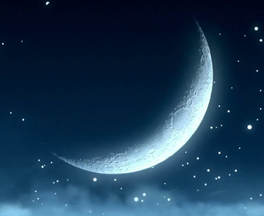

The Priesthood Was Corrupt!
Yahuah knew this from the foundation of the world, yet He tried everything He could to work with their rebellion
to allow every evening sacrifice
to be acceptable to Him.
That’s something to think about!
Next: Passover
puzzle pieces!
72
Notes:
You asked the question about "why in Canaan" when the corrupt priests changed the times for the sacrifices. My answer: The command from Moses in Deut 16 was "when they come into the land" ... remember there were no passovers in the wilderness after year #2, so these instructions are for "coming into the land" ... of what? ... of Canaan, right? Then, he said "at the place where Yahuah places His name, you go there for passover" ... well, that is Jerusalem, IN JUDAH by that time -- after the land of Canaan was split into 12 tribe divisions. I could say Jerusalem - but that's not totally correct, because Joshua celebrated Passover when he crossed the Jordan into "their" canaan. So, that is why I used canaan. Do you think another term is more correct to identify what Deut 16 is talking about - as this is coming up in part 2? But, trouble is: it has to be done correctly in part 1. So, I felt "canaan" was a safer term "all around" than "Jerusalem" which didn't come about for some time, nor the tribe of Judah. That all took time to divide up the land for the inheritances. Let me know if you want canaan changed out.

Slide 73

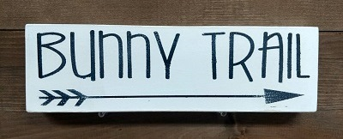
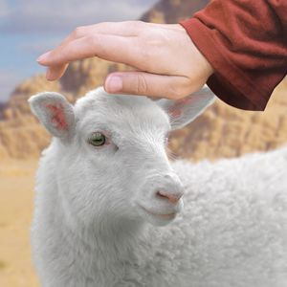
General Facts About:
Several general facts need to be considered about
the Passover sacrifice before going further in this study.
Both the Day Season and the Night Season qualify for “between the mixingS” in the Old Testament:
Every family was required to have their own Passover sacrifice and eat it during the Night Season until Messiah comes. Never was there just one Passover sacrifice offered for the whole nation. Each family’s Passover lamb sacrifice was a requirement of Exodus 12 for the next 1500 years up to Yahusha’s sacrifice.

Slide 74
General Facts About:
(General) Passover facts for “between the mixingS” continued:
When the Passover was eaten during the Night Season,
the story was to be related to their family in remembrance
of what happened in Egypt.
Beginning with Exodus 12, every Passover lamb was a “type”
that had fulfillment through Yahusha’s “anti-type” sacrifice.
The Passover sacrifice was unique being “offered” “between
the mixingS” – which could be either the Day Season,
or the Night Season depending on the circumstances
given in the content and the context of each individual Scripture that uses <beyn ha arbayim>.
The Passover sacrifice was always eaten during the Night Season.

Slide 75
6 Prime Examples: Old Testament
1491 BC Exo 12 (Narrative) – Egypt: The Passover lamb was sacrificed and eaten during the Night Season due to circumstances of Egyptian bondage during the Day Season.
  1490 BC Lev 23 (Command) – Wilderness timeframe:
  General instructions for sacrificing the Passover that would have
  been performed during the Day Season due to the large volume
  of sacrifices, then always eaten during the Night Season.
1490 BC Num 9 (Narrative) – 2nd year in the wilderness: Passover sacrificed during the Day Season 14 days after
the wilderness sanctuary was raised up. It would have been eaten during the Night Season. This is the last Passover celebrated in the wilderness.
Tim: As I went through these passover examples YET AGAIN. I realized that not all of them are passover celebrations - some are actual COMMANDS such as Lev 23:5 and Deut 16:6. That left "9" in the list, until I realized I forgot the "Narrative & Command" for the next Passover at the Last Supper.

Slide 76


What is Moses commanding?
1451 BC Deut 16:6 (Command – 40 years later)
In this Scripture Moses is definitely giving a command about Passover Sacrifices near the end of his life … and … it is considered a very controversial verse which will be explained in detail later after the
complete research has been
completed for …
“between the mixingS (evenings).”
76

Slide 77
6 Prime Examples: Old Testament
1451 BC Joshua 5 (Narrative) – Crossing the Jordan River: Passover sacrificed during the Day Season upon entrance into
the land; eaten during the Night Season.
726 BC 2 Chron (Narrative) – King Hezekiah’s reformation at Jerusalem: Passover kept in the 2nd month for 14 days. Sacrifices during the Day Season; sacrifice eaten during the Night Season.
624 BC 2 Kings 23; 2 Chron 34 & 35 (Narrative) – King Josiah’s reformation at Jerusalem: 41,400 Passover sacrifices offered during the Day Season, through the twilight mixture - right
up to the night; eaten during the Night Season.
536 BC Ezra 6 (Narrative) – Return from Babylonian captivity: Priests and Levites sacrificed the Passover lambs for all the congregation during the Day Season; eaten during the
Night Season.

Slide 78
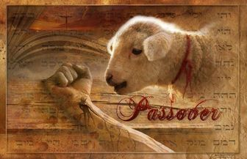
4 Prime Examples: New Testament
Yahusha’s Passover Luke 2 (Narrative) – at age 12 in Jerusalem.
Yahusha’s Passover John 2 (Narrative) – at the beginning of His ministry.
Last Supper Passover Instructions Synoptic Gospels (Narrative & Command) – at the end of Yahusha’s ministry. In the last part of this story, Yahusha also gives a command of when they will celebrate the next Passover together. (Matt 26:29; Mark 14:25; Luke 22:15.)
Crucifixion Day John 19 (Narrative) – Yahusha’s Passover
sacrifice at the end of His ministry from the 3rd hour to the 9th hour.
All the Passover sacrifices for the previous 1500 years, were “types” that Yahusha’s sacrifice fulfilled through His “anti-type” sacrifice.
(More on the Gospel Passover’s in Part 2.)
What do all these Passover “Narratives & Commands” have to do with <beyn ha arbayim>?

Slide 79
C) Sacrificing the Passover Lamb
In Egypt the Passover sacrifice and meal was during the Night Season.
Only when the Hebrews came into the land was the sacrifice during
the Day Season. The meal was always eaten during the Night Season.
#6
Exo 12:6
Egypt
Exo 12:6 And ye shall keep it until the fourteenth day of the same month: Then the whole assembly of the congregation of Israel shall kill it in the evening (between the mixingS:
or <beyn ha `arbayim>).
Note #1: Exo 12:6 applies directly to the Passover lamb in Egypt for the first time in Torah. “Between the mixingS” can be applied to either the Day Season or Night Season. The Night Season option applies only to Exodus 12 when in Egypt.
It is now time to consider some extra information that will shed light on not only what happened in Egypt that night, but why this phrase “between the mixingS” comes to
the forefront.

Slide 80
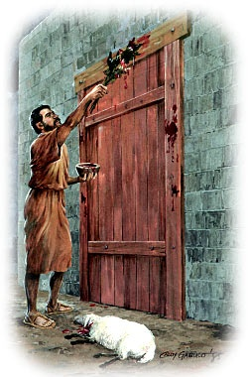
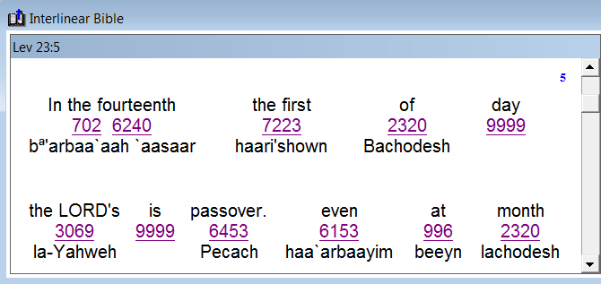
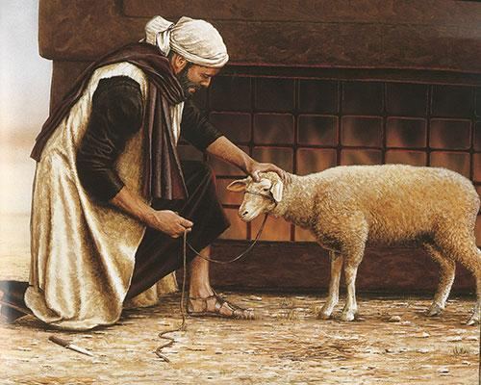
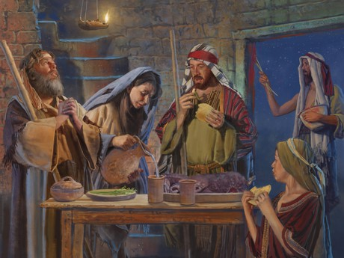
C) Sacrificing the Passover Lamb
Note: Lev 23:5 is written by Moses as a general command for Passover. In general, this verse could apply to both the sacrificing and eating of the Passover lamb until Yahusha takes that place.
#7
Lev 23:5
Command
Lev 23:5 In the fourteenth day of the first month at even (between the mixingS: or <beyn ha `arbayim>) is Yahuah's Passover.
3 Definitions
for Passover
Passover
Day
Passover
Sacrifice
No mention of day-start
information in Lev 23:5.
Passover Meal

Slide 81
Recalling Exodus 12 History
At this point in time the Hebrews were forced to work under the cruelty of harsh Egyptian masters!
The increased pressure that was mounting over the Hebrews since ALL the previous plagues had led to much harsher slavery and inspection!
This forced work would have been required all through the daytime hours (7 days a week).
The only time the Hebrews would find relief from
this slavery was during the night hours.
Yahuah’s instruction to kill their lamb and ‘not be outside their house’ would not likely be possible
to take place in the daytime season at all.
[Psalm 104:23 mentions man is to work/labour until the evening.]
Yahuah gave the command for the sacrificing and partaking of the Passover lamb under these extreme conditions. When was this to be accomplished
if the Hebrew’s were continually under the searching eye of their Egyptian task masters?
Through utmost mercy, Yahuah did not command the Hebrews to sacrifice their Passover lamb when there was day light
[or sunlight] in the sky. Why?
  1ST: they couldn’t do such a thing under their slave masters.
  2ND: This action would put them at a dangerous risk for the Egyptians to see & question the Israelites killing their lambs
  in daylight. Remember, they were under intense slave labor during the light hours.
However, the most pinnacle plague was mounting upon the Egyptians (the death of all “the first born” of man and animals – princes and their god animals). Yahuah knew this pressure on the Egyptians would force them to finally release the Israelites.

Slide 82

The Passover Lamb of Egypt
This divine plan was
too critical to take on
any risk that the Egyptians would find out too soon what was to occur.
Therefore, of great necessity, the Passover lamb sacrifices were
done in the dark
(under any available moon light) for their own safety
and protection.
The Passover lamb was a member of the family household for 4 days before being offered as the sacrifice in place of the firstborn of the home.
“between the mixingS” in Exo 12:6 applies to the Night Season “after dusk.”

Slide 83


Passover Sacrifices in Egypt
The phrase “between the mixingS/eveningS”
allowed for the Passover sacrifices
to be preformed during
the Night Season.
Dawn
Dawn
#6
Exo 12:6
Egypt
#7
Lev 23:5
Command
Sunrise
Sunset
beyn ha arbayim
Night Season
(between two mixingS)
Direct Sunlight
Darkness
Has there been anything to indicate
that “between the mixings”
is linked to the day-start?
No!
1. beyn ha arbayim
Day Season
(between the mixings)

Slide 84

C) Sacrificing the Passover Lamb
  Num 9:3 In the fourteenth day of this month, at even (between the mixingS <beyn ha `arbayim>), ye shall keep it in his appointed season: according to all the rites of it, and according to all the ceremonies thereof, shall ye keep it.
#8
Num 9:3
Command
For
Canaan
Is there anything in the Num 9:3 command to indicate that
“between the mixingS” is
linked to the day-start?
No context
for day-start.

Slide 85


Historical Evidence From Josephus
INFORMATION
Every year on Passover Day, in Jerusalem, there were many Passover
lambs slain, not just one.
Josephus, the Jewish historian, has some historical evidence
(Wars of the Jews, Book VI, 9:3).
This quote exposes his personal experience of just when the evening sacrifice was performed fulfilling
the prophetic guidelines
of Daniel.
  "So these high priests, upon the coming of their feast which is called
  the Passover, when they slay their sacrifices, from the ninth hour to the eleventh, [3 pm to 5 pm Roman time] but
  so that a company not less than ten belong to every sacrifice . . . and many of us are twenty in a company, found this number of sacrifices was two hundred and fifty six thousand five hundred [256,500] which, upon
  the allowance of no more than ten that feast together, amounts to two million seven hundred thousand
  and two hundred persons that
  were pure and holy."
(Note: Some historians quote 270,000 Passover sacrifices/day.)

Slide 86

Recalling History for Canaan’s Passover
At this point in time the Hebrews have much more freedom and protection.
Once in the land of Canaan, the situation for offering the Passover lamb was not as serious.
After Jericho’s demise, the people were required to attend Passover in Jerusalem. (See Deut 16:11.)
With the large attendance, thousands of lambs/goats were killed on every Passover day.
Josephus recorded these sacrifices were during the timeframe of 3 PM
to 5 PM of the Day Season.
“between the two twilight mixingS”
(or “sunrise to sunset”) includes more than 2 hours from 3 PM to 5 PM.
The option of “between the mixingS” gives plenty of time for all the lambs to be sacrificed rather than waiting for just a few moments of dusk twilight.
Yahuah facilitated this provision so the priests would have time to assist everyone with their own Passover lambs.

Slide 87
Passover Sacrifices in Canaan
The phrase “between the mixingS/eveningS”
allowed for the Passover sacrifices
to be preformed during the full
Light Season.
Dawn
Dawn
#7
Lev 23:5
Command
#8
Num 9:3
Canaan
1. Up to [approx.] 270,000
Passover Sacrifices
performed during
the Day Season.
Sunrise
Sunset
beyn ha arbayim
Day Season
(between two mixings)
beyn ha arbayim
Night Season
(between two mixings)
Direct Sunlight
Darkness
Question: Does Moses give permission for Passover sacrifices to be offered during the Light Season before high noon?
No context
for day-start.
We shall see!
87

Slide 88

King Josiah’s Passover in Jerusalem
King Josiah’s 41,400 Passover sacrifices were preformed during the Light Season up to the night [H3915].
The phrase “between the mixingS/eveningS”
does not apply for the dusk twilight time.
Dawn
Dawn
The ONLY allowed placement
for <night/H3915> begins with
the darkest part of DUSK,
ushering in <layil> night.
Sunrise
Sunset
DUSK
beyn ha arbayim
Day Season
(between two mixings)
beyn ha arbayim
Night Season
(between two mixings)
Direct Sunlight
Darkness
2 Chron 35:14 … the sons of Aaron, were busy in offering burnt offerings and fat until night [layil] … NKJV
No context
for day-start.
88

Slide 89


D) Partaking of the Passover Lamb
Both Num 9:5 & 11 address partaking of the Passover lamb – always eaten during the Night Season.
Num 9:5 And they kept the passover
on the fourteenth day of the first month at even (between the mixingS)
in the wilderness of Sinai: according
to all that Yahuah commanded Moses …
#9
Num 9:5
1st Month
#10
Num 9:11
2nd Month
Num 9:11
The fourteenth day
of the second month
at even
(between the mixingS) they shall keep it, and eat it with unleavened bread and bitter herbs.
No context
for day-start.
The context has no mention of day-start.

Slide 90
Passover Meal in 1st & 2nd Months
The phrase “between the mixingS/eveningS”
allowed for two Passover requirements
(sacrificing & partaking)
“between the two mixingS.”
Dawn
Dawn
#9
Num 9:5
1st Month
#10
Num 9:11
2nd Month
Sunrise
Passover sacrifices during the
Day Season
Sunset
Passover meal
during the
Night Season
beyn ha arbayim
Day Season
(between two mixings)
beyn ha arbayim
Night Season
(between two mixings)
Direct Sunlight
Darkness
The Passover Sacrifice could be offered anywhere within the 24 hours
(on the 14th), but the meal was always eaten in the Night Season.
Left-overs were disposed of before the new DAWN day began.
No context
for day-start.
90

Slide 91

E) Aaron Lights the Sanctuary Lamps
Introduction:
This last section seems like it should be easy – but it is tricky!
Some answers will be given in this section; some answers in the next section.
The conclusion cannot be formulated until Lev 6:20 has careful consideration.
Only the “evening care” of the lamps will be addressed, not the morning care.
#11
Exo 30:8
Sanctuary
Lamps
The timeframe for the care of the sanctuary lamps was connected to both the morning
and evening Daily Sacrifices.
The care of these lamps is also connected to the phrase “between the mixingS.”
Question: Does this mean that the lamps could have been tended to in either the Day Season, or the Night Season as both options qualify for “between the mixingS”?
Split the slide. 1st slide comment: The phrase in this verse allows for 2 options of lighting the lamps. The term “between the mixingS” includes both the Day Season and the Night Season. In the next part of this study, Lev 6:20 shows the grain offering was offered with the sacrifice up until the “6153” using the “night” definition – this would be just before the pitch dark of night. Also, in the next part of this study: there were days that had many sacrifices, that could have placed the daily evening sacrifice much later than 3 PM – using the logical reasoning that the “evening sacrifice” was always THE last sacrifice of the day. So what is the answer? When did Aaron light these lamps? I don’t think it had to be at a set time everyday. It seems there is a fair amount of leeway given here, depending on when the evening daily sacrifice is offered. But the final conclusion cannot be shown UNTIL Lev 6:20 and the information on the yearly sacrifices is given in the last part of this study.
So, should this slide be left with this question and then brought up again after part 5? Lev 6:20 is the verse that has the answer, so I don’t see how this slide can come to a final conclusion until Lev 6 is brought forward. This is what happens with these bunny trails. I don’t think this is the place to bring Lev 6:20 forward, if I’m splitting the PPT here. What a conundrum!

Slide 92

E) Aaron Lights the Sanctuary Lamps
Split the slide. 1st slide comment: The phrase in this verse allows for 2 options of lighting the lamps. The term “between the mixingS” includes both the Day Season and the Night Season. In the next part of this study, Lev 6:20 shows the grain offering was offered with the sacrifice up until the “6153” using the “night” definition – this would be just before the pitch dark of night. Also, in the next part of this study: there were days that had many sacrifices, that could have placed the daily evening sacrifice much later than 3 PM – using the logical reasoning that the “evening sacrifice” was always THE last sacrifice of the day. So what is the answer? When did Aaron light these lamps? I don’t think it had to be at a set time everyday. It seems there is a fair amount of leeway given here, depending on when the evening daily sacrifice is offered. But the final conclusion cannot be shown UNTIL Lev 6:20 and the information on the yearly sacrifices is given in the last part of this study. So, should this slide be left with this question and then brought up again after part 5? Lev 6:20 is the verse that has the answer, so I don’t see how this slide can come to a final conclusion until Lev 6 is brought forward. This is what happens with these bunny trails. I don’t think this is the place to bring Lev 6:20 forward, if I’m splitting the PPT here. What a conundrum!
Exo 30:7 (The lamps were dressed in the <boqer> morning. Then …)
Exo 30:8 And when Aaron lighteth the lamps at even
(H6153 between the mixingS / beyn ha `arbayim), he shall burn incense upon it, a perpetual incense before Yahuah throughout your generations.
#11
Exo 30:8
Sanctuary
Lamps
Note:
The phrase “beyn ha arbayim” is present.
For verse 8, the lamps were tended to by Aaron after the evening sacrifice, when incense was burning on the Altar of Incense. Depending on the sacrificial duties the lamps could have been taken care of during the latter part of the Day Season – toward evening, There is nothing to indicate this was done during the Night Season.
One website said: The lamps were trimmed and lighted at the same time of the evening sacrifice (Exodus 30:8) and trimmed and filled at the same time of the morning sacrifice (Exodus 30:7; 1 Samuel 3:3).
Notes:
This olah tamiyd sacrifice was connected to the rising and setting of the sun as implied by the words of the psalmist (Ps 113:3). At the same time, the priest was to burn incense on the incense altar (Exod 30:7–8) as part of the olah tamiyd sacrifice.
Ezek 46:13-15 Every day you are to provide a year-old lamb without defect for a burnt offering to the LORD; morning by morning you shall provide it. 14 You are also to provide with it morning by morning a grain offering, consisting of a sixth of an ephah with a third of a hin of oil to moisten the flour. The presenting of this grain offering to the LORD is a lasting ordinance. 15 So the lamb and the grain offering and the oil shall be provided morning by morning for a regular burnt offering. (from New International Version)
Here's what we know about the evening sacrifice: https://hermeneutics.stackexchange.com/questions/6359/what-time-was-the-evening-sacrifice-in-1-kings-1827
"EVENING SACRIFICE. The daily burnt offering of a yearling lamb. With the morning sacrifice it constituted the continual burnt offering. Each sacrifice, a lamb without blemish, was offered with a cereal (“meal,” KJV “meat”) offering, one-fifth peck of fine flour with a quart of oil; and a libation, a quart of wine (Exod 29:38-42; Num 28:3-8). The observance was important in the history of Israel (2 Chron 13:11, et al.). The continual burnt offering of the restored temple of Ezekiel included only the morning sacrifice (Ezek 46:13-15)."

Slide 93
Lighting the Sanctuary Lamps
The phrase “between the mixingS/eveningS”
is used for the care of the lampstand
along with the evening sacrifice.
For Exo 30:8, this coment is correct. But things can change with Lev 6:20. Hhmmm.....
Dawn
Dawn
#11
Exo 30:8
Sanctuary
Lamps
Sunrise
Lamps tended to
with the daily
evening sacrifices.
DUSK
Sunset
beyn ha arbayim
Day Season
(between two mixings)
beyn ha arbayim
Night Season
(between two mixings)
Direct Sunlight
Darkness
No context
for day-start.
Will Lev 6:20 offer another option for not only the daily evening sacrifices, but the trimming of the lamps that happened at the same time??
We shall see!
I've left this slide and section with a question below, and a "we shall see" that will be answered with Lev 6:20.
93

Slide 94






This completes Part #1 of the study for
11 Torah Scriptures for <beyn ha arbayim>.
Exo 16:12
Exo 29:39
Exo 29:41
Num 28:4
Num 28:8
Exo 12:6
Lev 23:5
Num 9:3
Num 9:5
Num 9:11
Exo 30:8
#2
<beyn ha arbayim> has a special connection to every Passover sacrifice.
#1 Not one Scripture had
a command for this phrase to commence the day with dawn, sunset or evening.
#3 The focus on this phrase was to show <beyn ha arbayim> can have placement during the Day Season or Night Season ~ depending on the context!
“Between the mixingS” provides for perfect fulfillment of ALL Passover sacrifices and ALL sacrificial types through Yahusha’s singular Passover Sacrifice.
94

Slide 95
2. What about
Lev 6:20 &
Deut 16:6?
1. The Patterns for
“between the mixingS”
in the Torah had
alignment with
the Day Season
& Night Season,
NOT DAY-START!
What about
Patterns for
“between the eveningS”
on Yahusha’s
Passover Day?
No context
for day-start.
Part #2 will examine questions 2 & 3 to see if there is any
connection to “beyn ha arbayim” and if so, what is it?
95

Slide 96
Do you think this is true?
Prov 25:2 KJV
It is the glory of Yahuah to conceal a thing:
but the honour of kings is to search out a matter.
There is still more to search out!
The End
96

Slide 97




If you have Questions & Comments
about this teaching, please contact:
Charlene Fortsch or Tim Astleford
charlene@studythecalendar.com
tim@studythecalendar.com
Thank you!

